Slide 1
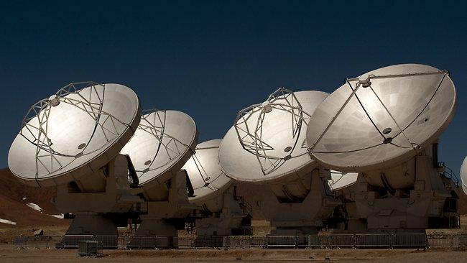
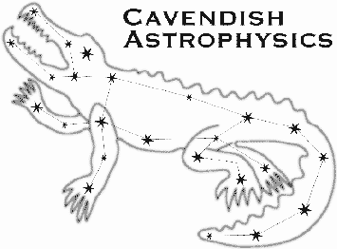
ALMA reveals a rotating [CII] disk in a gas rich galaxy at z = 4.76
Rebecca Williams
Cavendish Astrophysics
(rw480@mrao.cam.ac.uk)
Collaborators:
Carlos De Breuck, Mark Swinbank, Paola Caselli, Kristen Coppin, Timothy A. Davis,
Roberto Maiolino, Tohru Nagao, Ian Smail, Fabian Walter, Axel, Weiβ, Martin Zwaan
Notes:
How we have used ALMA to detect [CII] emission at very high redshifts and so trace star formation

Slide 2
ALESS73.1 (z = 4.76)
SMG at z = 4.76 with SFR ~ 1000 Myr⁻¹
Identified with AGN detected in the optical (unresolved) and x-ray, [Coppin+09].
ALMA
beam
HST image: Grogin+11, Koekemoer+11
Notes:
ALESS73.1 is located in the Extended Chandra Deep Field South (ECDFS).
Originally identified as a compact, high-z AGN and also a faint x-ray source.
Then detected as the most likely counterpart of a luminous submm source in LABOCA survey.
Although some SMGs contain luminous AGN, in 85% of cases this does not dominated the bolometric luminosity.
Higher resolution ALMA continuum obs. provide identification as a luminous SMG.

Slide 3
ALESS73.1 (z = 4.76)
New ALMA (cycle 0, 23 antennae) observation which spatially resolves [CII] λ157.74μm emission around ALESS73.1
High spatial resolution: beam 0.5” x 0.39’’
Our ALMA 330GHz continuum emission is marginally resolved [Gilli+14].
In contrast [CII] disk which extends to both sides (~4.4 kpc) [C. De Breuck et al., A&A, 2014 (submitted)]
Indicate a compact galaxy:
~1.9 kpc
ALMA
beam
HST image: Grogin+11, Koekemoer+11
Notes:
[CII] arises predominantly from photo dissociation regions associated with star forming regions and is the dominant cooling line.
Also re-observed the [CII] line with APEX (July 2013).

Slide 4
Observations
Gas emission detected:
[CII]
[NII]
¹²CO
  all redshifts are consistent
This work
Coppin +09,+10, Biggs+11, Wardlow+11,De Breuck+11, Nagao+12, Gilli+14
Notes:
[CII] line detected at 22sig and spatially resolved with FWHM=0.64’’ (4.1kpc)
APEX obs. do not detect [CII] with rms=16mJy -> still consistent with ALMA obs.
Consistent redshifts suggests that they are originating from gas with the same bulk motion.

Slide 5
Observations
Gas emission detected:
[CII]
[NII]
¹²CO
  all redshifts are consistent
New high S/N ALMA observation => can kinematically model the [CII] emission
This work
Coppin +09,+10, Biggs+11, Wardlow+11,De Breuck+11, Nagao+12, Gilli+14
Notes:
Aside:
[CII] traces multiple gas phases although has been argued to be a direct tracer of the fuel for star formation (Stacey 91)
If [CII] & CO are not tracing the same bulk motion then the lowest mass component (atomic gas traced by [CII] in this case) is outflowing compared to the higher mass component.
However do no detect any velocity shift between [CII] & CO and do not find a significant outflow component in [CII] .
Therefore assume that [CII] traced the kinematics of the underlying star-forming gas component.

Slide 6
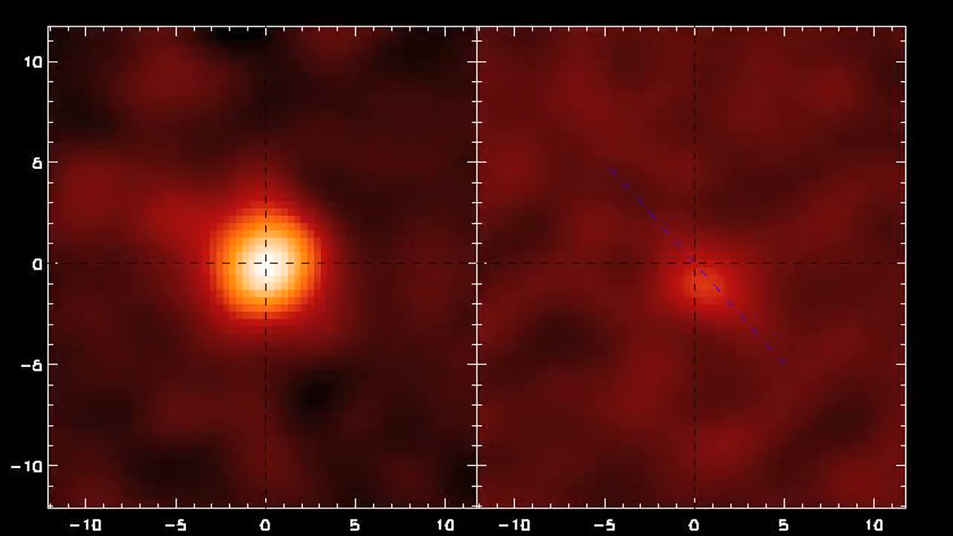
Notes:
Aside:
[CII] traces multiple gas phases although has been argued to be a direct tracer of the fuel for star formation (Stacey 91)
If [CII] & CO are not tracing the same bulk motion then the lowest mass component (atomic gas traced by [CII] in this case) is outflowing compared to the higher mass component.
However do no detect any velocity shift between [CII] & CO and do not find a significant outflow component in [CII] .
Therefore assume that [CII] traced the kinematics of the underlying star-forming gas component.

Slide 7
Velocity Model
Fit velocity field with dynamical model assuming a circularly rotating thin disk
(Beam size: 0.5’’ x 0.39” PA: 91°)
Field is dominated by rotation with no indications of major merging
De-projected velocity :
=> SFR ~ 1000 Myr⁻¹ (!!!) does not seem to be triggered by major dynamical disturbance
Notes:
Resolve [CII] emission over 0.6’’ with peak SNR=5-15 in each individual 25km/s channels.
Fit [CII] line with a single Gaussian.
Fit velocity field with a dynamical model assuming that the ionised gas is circularly rotating in a thin disk and that the disk surface mass density distribution is exponential.
Neglect any hydro dynamical effects therefore the disk motion is entirely determined by the gravitational potential.
Residuals < 10km/s
See no sign of mergers in velocity field
Also use continuum image to search for other sources within the ALMA primary beam and find no other galaxies within a projected radius of 40kpc with SFR>75M/yr (i.e. above 3sig)
Indicated it is unlikely to be a component of a mid-stage pre-coalescence merger.
So such high SFR are intriguing.

Slide 8
Velocity Model
PV diagram shows that luminosity is not constant.
Suggests disk is gas-loaded or preferentially heated on one side
Need higher spatial resolution to determine reliable flux distribution.
Notes:
PV diagram: taking a slit along the major axis of rotation and extracting the velocity and flux as a function of distance from the center of the disk.
Model shows good representation of the rotation curve
So although we see a regular rotating disk, the luminosity mass is not uniformly distributed which is consistent with a young/ newly forming disk.
i.e. SFR not uniformly spread out.
Significantly higher spatial resolution observations are needed to determine a reliable flux distribution within the disk.

Slide 9
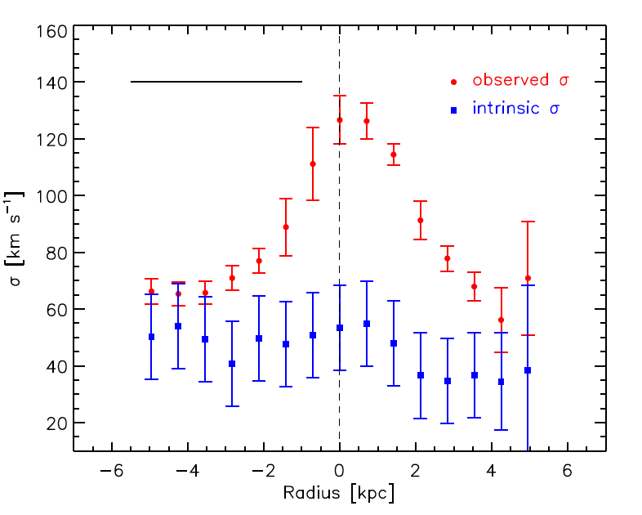
Velocity Dispersion
Calculate intrinsic velocity dispersion by removing beam smearing effects
Find:
V/σ = 3.1 ± 1.0
implies a highly turbulent rotating disk
σ = 40±10 km/s
Notes:
Important when calculating the intrinsic velocity dispersion that you account for beam smearing effects:
-> artificial broadening of the line due to the steep velocity gradient.
At each pixel we measure the luminosity weighted velocity gradient across the FWHM of the beam at that pixel and subtract this from the velocity dispersion.
Shown extracted along the major kinematic axis of the galaxy.
sig = 40 +- 10 km/s
A factor of ~3 lower than the value seen for local galaxies (v/o ~ 10)
Although optically thin [CII] emitting gas could also be due to the fact that we are observing a wider range of gas components.

Slide 10
Dynamical Mass
Circularly rotating disk model allows us to constrain the dynamical mass
Implies a dynamical mass within R = 4kpc of:
Conservatively accounting for other sources of uncertainty
Notes:
Show MCMC plot which attempts to break degeneracy between Mdyn and inclination.
As we do not resolve the flux distribution we also use additional models for the kinematics which give slightly higher dynamical masses and therefore quote the full range here.

Slide 11
Continuum Emission
Position of F160W image
[CII] contours
Using Schmidt-Kennicutt relation:
distributed within R < 1kpc
And:
=> “Extreme Starburst”
330GHz dust continuum image
Notes:
Explain plot,
Here the dust continuum is offest by 0.22’’ from the HST F160W idenifictaion, corresponding to ~1sig compared to the astrometric accuracy.
HST image unresolved at 0.2’’.
X-ray-> radio SED shows evidence for both AGN and stellar emission with the bolometric AGN contribution constrained to 2-20%.
AGN dominates the mid-IR & x-ray, though the weak mid-IR emission implies that this contribution is <20%, but may still outshine the rest-frame UV/optical emission.
Starburst is dominating in the far-IR
Compute luminosity using the Herschel limits and constraints on AGN contribution.
Star formation rate surface density (e.g. MW: ~ 0.003, Starbursts: ~ 3)
So well above main sequence (order of mag)
Specific star formation rates: sSFR > 80/Gyr
Galaxy will double its stellar mass in ~12Myr
And so observing galaxy in its first major burst of star formation.

Slide 12
Gas Disk
Previous CO(2-1) detection gives:
=> Combine with derived M_{dyn}:
[Coppin et al. (2010)]
Notes:
Note: Coppin compute molecular gas mass assuming low X_co=0.8 conversion factor, so adopting a higher X_co will decrease the limit on Mstar.
Obtain estimate of the atomic gas mass associated with the PDR using eq.
-> M_a ~0.47 x10^9 Msun
Use mass budget to put upper limit on conversion factor: X_co<2.3, i.e. half of the Galactic value but consistent with the range found at high-z.

Slide 13
Gas Disk
Previous CO(2-1) detection gives:
=> Combine with derived M_{dyn}:
[Coppin et al. (2010)]
Toomre stability criterion: stable if Q > 1
Find at all radii, Q < 1
=> gas disk is gravitationally
unstable at all radii
Notes:
Regular rotation pattern indicates that the gas has had sufficient time to settle in a bulk motion despite the fact that the rotation period at the outer edge of the disk is 16% of the age of the Universe.
If gas is regularly rotating, could it still fuel the central starburst.
Disk is unstable at all radii -> with the lack of a merger this indicates that the extremely high SFR are due to such large supply of gas (which is gravitationally unstable)!

Slide 14
Metallicity
Can further constrain [NII]/[CII] ratio
This ratio is used as a new probe of metallicity (Nagao+12)
Notes:
Line ratio is a powerful new probe of the metallicity in the ISM
Free of extinction effects seen in optical & near-IR lines.
Uncertainty is dominated by model rather than the measurements.
(Cloudy simulations depend on gas density and ionisation parameter)**.
**
Under the very strong radiation field due to extreme star-formation, the relative volume ratio of HII regions and PDRs could change systematically. I.e. The relative PDR contribution becomes smaller for more active star-forming galaxies.
This will reduce the [CII] flux while [NII] is not affected. This increases the ratio so subsolar metallicities are still possible.
Obs. Of other fine lines are needed to determine the contributions from HII and PDRs to derive an accurate metallicity.

Slide 15
Metallicity
Can further constrain [NII]/[CII] ratio
This ratio is used as a new probe of metallicity (Nagao+12)
Find gas metallicity close to solar:
=> Highly enriched material already spread over several kpc
Notes:
Strengthens the conclusions of Nagao that galaxy already has a metallicity close to solar when the Universe was a mere 1.2Gyr.
Highly enriched gas has been detected before in broad line regions surrounding AGN, but these obs. suggests that highly enriched material may already be spread out over kpc scales (at such early times)!

Slide 16
Next step…
Exploiting ALMA to trace less extreme systems (much less massive and much lower SFR)
1’’
6.6kpc
z ~ 4.7
Wagg+12, Carilli+13, Carniani+13
Notes:
Use ALMA to study galaxies with my lower SFR therefore more representative of the galaxy population then.
Give an example from other work I have been doing: BRI1202, detected with ALMA in continuum & [CII] (contours)

Slide 17
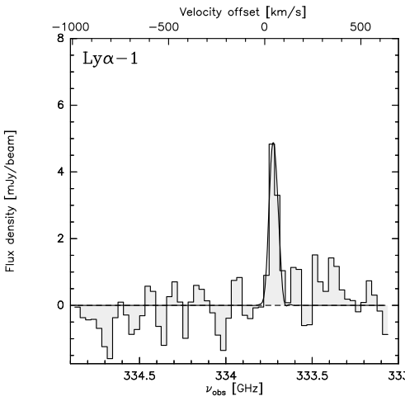
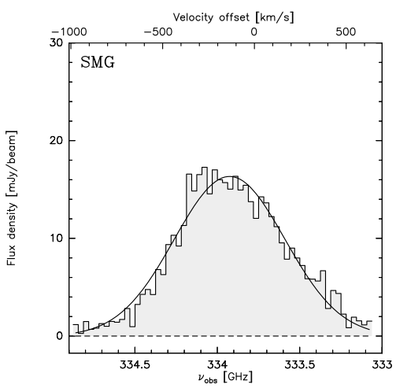
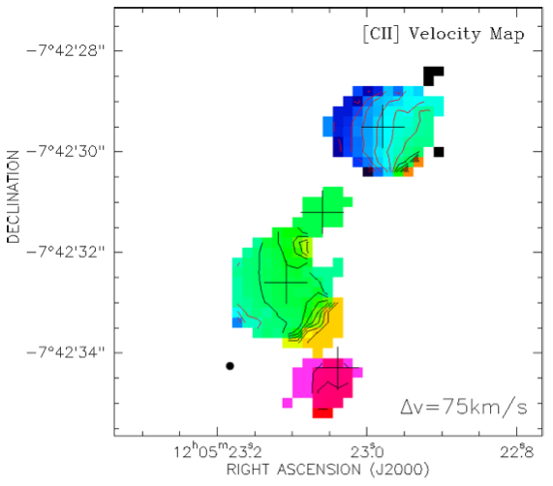
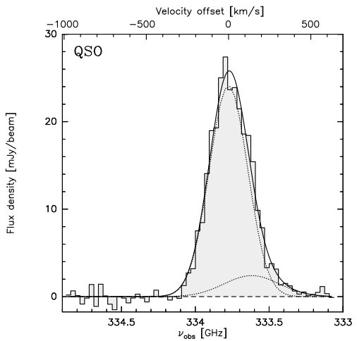
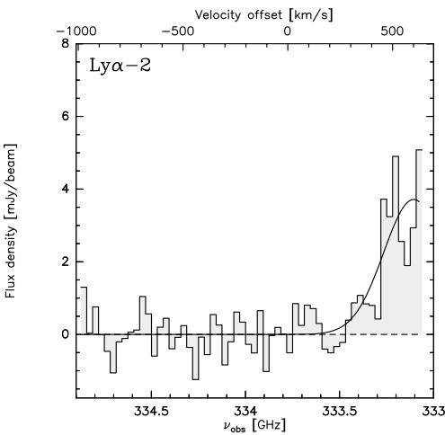
Next step…
[CII] velocity map
SFR ~ 20 Myr⁻¹
SFR ~ 3000 Myr⁻¹
SFR ~ 3000 Myr⁻¹
SFR ~ 70 Myr⁻¹
Notes:
Detect serendipitous galaxies when observing QSO-SMG with high SFR.
These are LAE with much lower SFRs.
Again able to model the kinematics.
We went after the lya emission in the optical…

Slide 18
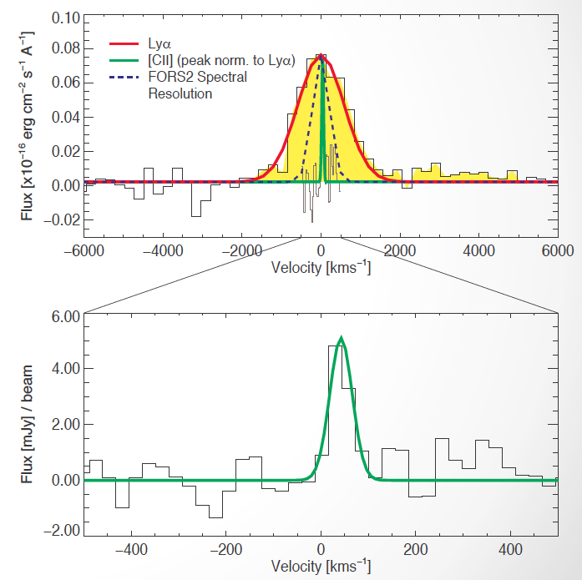
[R.J. Williams et al. (2014)]
Next step…
Lyα
[CII]
Similar results for Lyα-2
Never seen so far in other galaxies at high-z (but previous studies high M & high SFR)
Never seen in local galaxies
Notes:
Found dramatically different distributions between [CII] & lya -> lya much wider.
Similar results for the 2nd galaxy.
Such different distributions have not been seen before

Slide 19
[R.J. Williams et al. (2014)]
Next step…
Lyα
[CII]
Similar results for Lyα-2
Quite peculiar distribution of ionized (Lyα) and neutral ([CII]) gas in high-z galaxies
(also observed at even higher redshift -> see Maiolino’s talk tomorrow)
But expected by recent simulations of primeval galaxies (Vallini+13)
Notes:
Found dramatically different distributions between [CII] & lya -> lya much wider.
Similar results for the 2nd galaxy.
Such different distributions have not been seen before

Slide 20
Conclusions
  New spatially resolved ALMA [CII] observations of z=4.7555 submm galaxy ALESS 73.1
  Find [CII] emission consistent with a regular, but highly turbulent, rotating disk
  High SFR (~1000Myr⁻¹) and low derived stellar mass suggests we are observing first major burst of star formation
  Demonstrates ALMA’s potential to extend dynamical analysis out to such early epochs
  Future to observe galaxies with lower SFRs, more representative of population and trace different star formation environments
Notes:
While ALMA is still limited in spatial resolution, it is not in SNR.

