Slide 1

Stellar Kinematics with SAMI
Lisa Fogarty
CAASTRO/University of Sydney

Slide 2
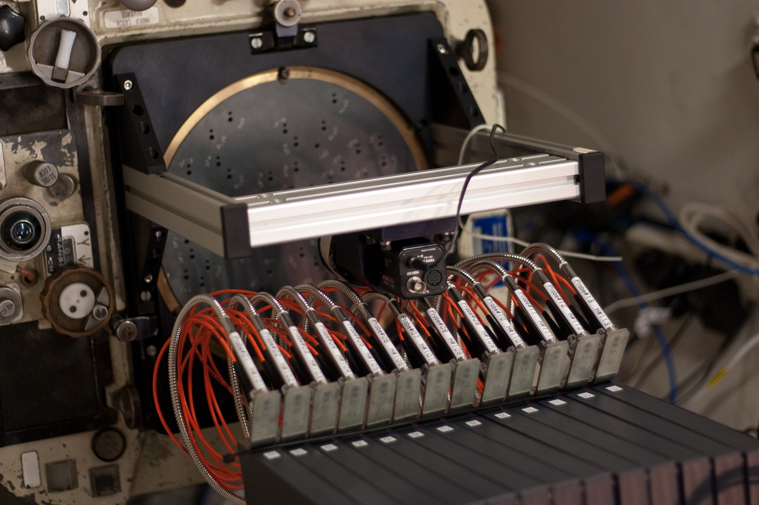
The SAMI
Galaxy Survey

Slide 3
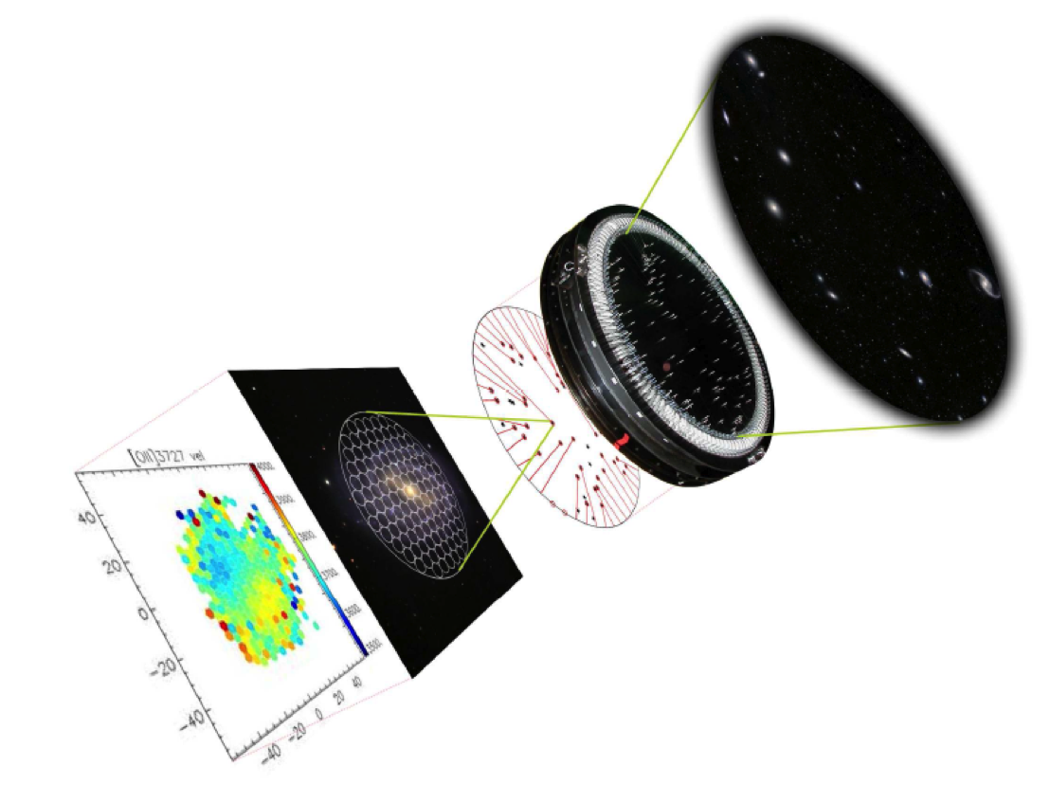
SAMI
Sydney-
AAO
Multi-object
Integral field spectrograph
Notes:
An implementation of IFUs here in Sydney

Slide 4
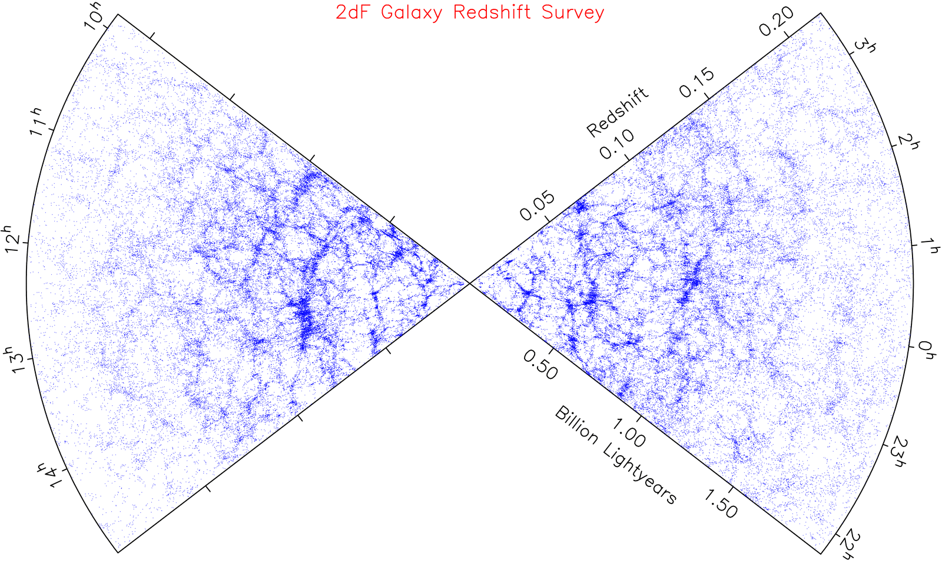
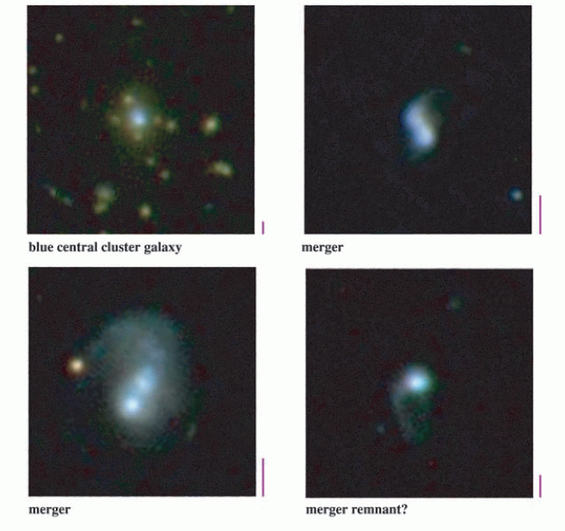
Why Multi-IFS?
IDEAL: Integral Field Spectroscopy of
a large sample of galaxies!
Kauffmann et al. (2005)
Colless et al. 2001
Notes:
Why do we care?? Gal surveys are awesome. The biggest surveys (2df, sdss) were performed using multi-object spectroscopy of tens (hundreds!) of thousands of galaxies. These vast samples revolutionised our ideas of galaxy formation and evolution entirely. Global handle on distribution of galaxy properties – for example luminosity functions, etc.
But galaxies are complex systems, in the case of single fibre surveys you’re reducing the entire galaxy to a set of representative numbers. By definition we’re reducing the complexity, by necessity, to something managable, and crucially, observable!
All sdss gals which are not morphologically well behaved, each with it’s own unique morphology etc. it’s difficult to know where to place your single fibre to observe these objects.
Not going to start talking about aperture effects! But clearly by attempting to re-coup the info we’re missing from single fibre surveys using IFS we can once again redefine how we think about galaxies.

Slide 5
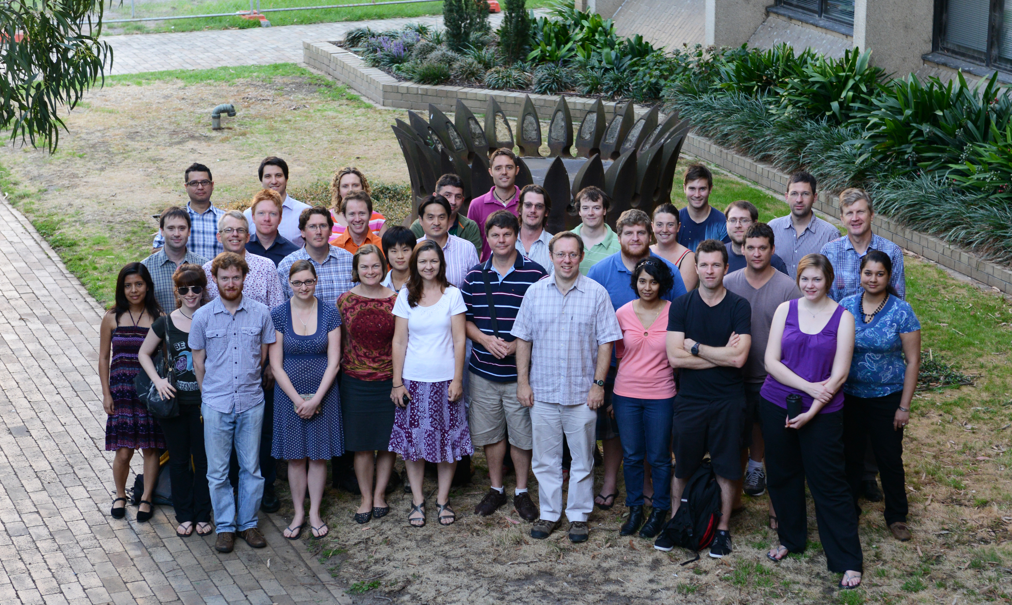
The SAMI Galaxy Survey

Slide 6
The SAMI Galaxy Survey
Physics of galaxy transformations.
Gas Flows in galaxy evolution.
Build up of mass and angular momentum.
3400 galaxies.
3 years – awarded 151-181 nights on AAT!
Already underway! ~650 galaxies already!

Slide 7
Target Selection
Environment Considerations.
Field and Group: GAMA.
  Steller Mass cut, staggered with redshift
Clusters: 8 Clusters from SDSS and VST.
  Selection currently incomplete

Slide 8
Target Selection

Slide 9
SAMI Associate Membership
Associate membership status available.
Propose a specific project.
Access to SAMI data for that project.
Contact: scroom@physics.usyd.edu.au
OR come and talk to me this week!

Slide 10
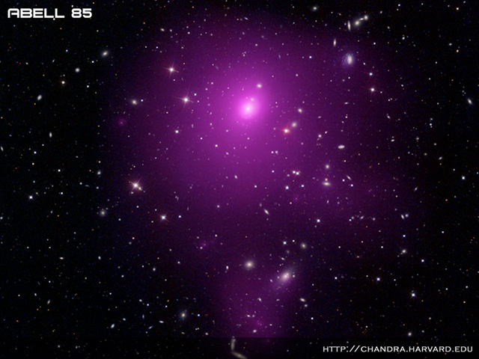
The Science
Notes:
SHOULD HAVE 10 MINS LEFT.

Slide 11
The SAMI Pilot Survey
3 galaxy clusters.
Abell 85, Abell 168, Abell 2399
106 galaxies in 10 nights.
  80 ETGs (non-spirals!)
  Investigate stellar kinematics in clusters
Particularly interested in internal kinematics of ETGs.

Slide 12
Kinematic Classification
Slow Rotators
- Low angular momentum
High mass
Have KDCs
Misaligned
Mildly Triaxial
15%
Fast Rotators
- High angular momentum
Lower mass
Regular rotation
Aligned
Axisymmetric (could contain disks and bars)
85%
By and large they look the same!
How to they form?

Slide 13
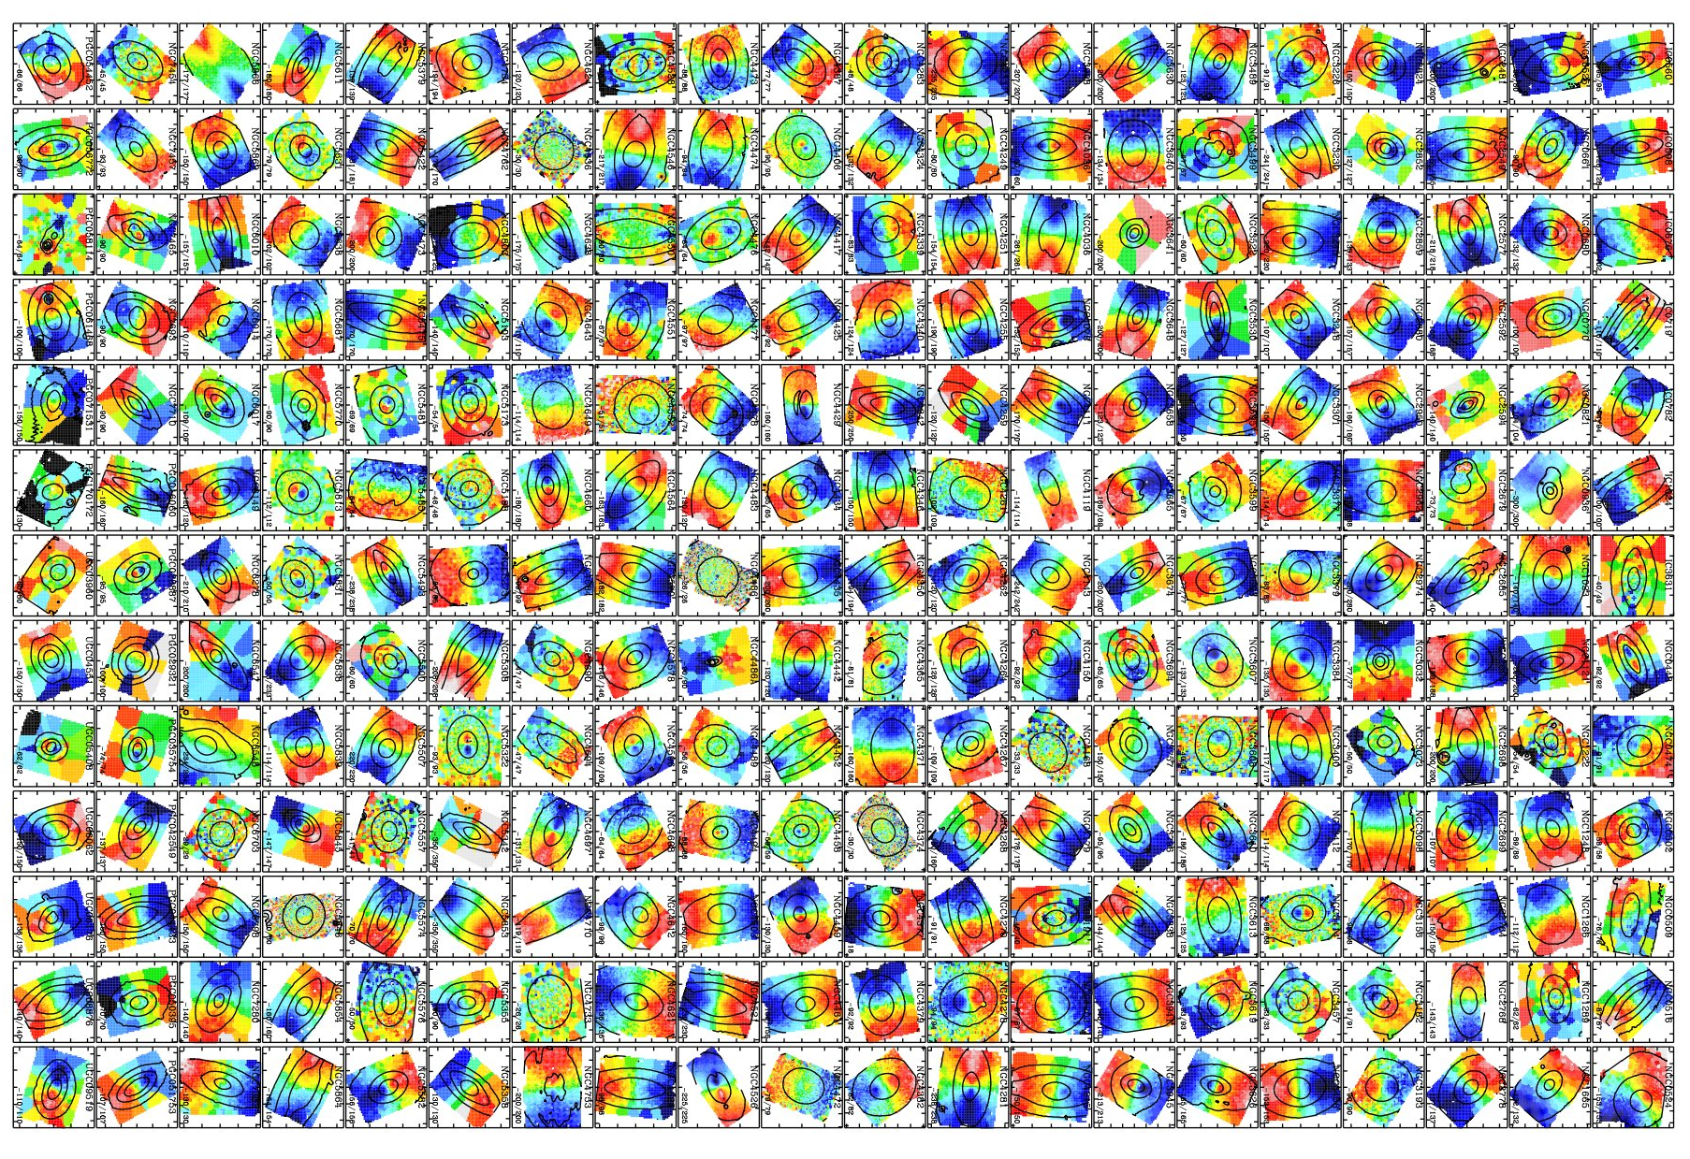
Kinematic Morphology
Large IFS sample: ATLAS-3D
Emsellem et al. 2011
Krajnovic et al. 2011

Slide 14
Kinematic Morphology-Density Relation
Galaxy Fraction
FR
SR
Density
Cappellari et al. 2011

Slide 15
Kinematic Morphology-Density Relation
f_{SR}
Abell 1689:
D’Eugenio et al. 2013
Coma:
Houghton et al. 2013
Density

Slide 16
SAMI Stellar Kinematics
Fogarty et al. in prep.

Slide 17
Classification
f_{SR}=25%
f_{SR}=17%
λ_{R}
f_{SR}=13%
f_{SR}=18%
Ellipticity

Slide 18
Morphology-Density Relation
f_{SR}
Density

Slide 19
On-Sky Distribution
Abell 85
Abell 168
Abell 2399
SRs in Outskirts
Cluster Merger
BCGs=FRs
Brough et al. 2011
Jimmy et al. 2013

Slide 20
Abell 85
Images created by Matt Owers

Slide 21
Conclusions
Overall f_{SR} remains roughly constant.
We see SRs on the outskirts of clusters!
Some evidence to connect these to in-falling groups.
Groups important formation regions for SRs.
Comparison with simulations.
Images created by Matt Owers

Slide 22
SAMI Associate Membership
Associate membership status available.
Propose a specific project.
Access to SAMI data for that project.
Contact: scroom@physics.usyd.edu.au
OR come and talk to me this week!

Slide 23
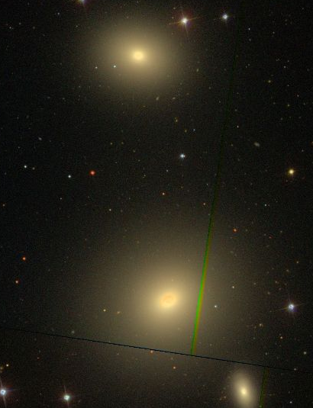
ETG Dichotomy
NGC3607
NGC3608
Both galaxies have similar shapes, colours, Sersic n, etc.
Thanks to Nic Scott for the slide!

Slide 24
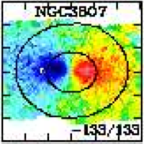
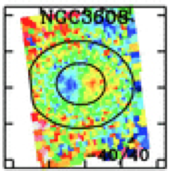
ETG Dichotomy
NGC3607
NGC3608
But their kinematics tell a different story.
Thanks to Nic Scott for the slide!

