Slide 1


PROBING THE END OF THE REIONIZATION EPOCH WITH THE MOST DISTANT GALAXIES
Laura Pentericci
INAF -Osservatorio Astronomico di Roma
in collaboration with
A. Fontana A. Grazian M. Castellano E. Vanzella
EWASS “30 years of Italian participation to ESO 2nd July 2012

Slide 2
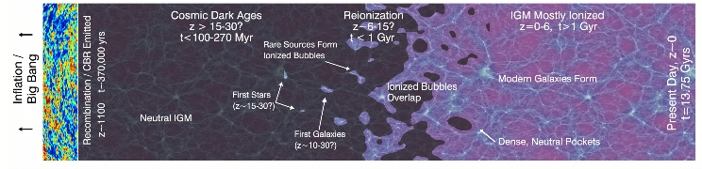
A schematic view of cosmic history
Dark Ages: Universe is mostly neutral
Future observations:
- redshifted HI spin-flip emission (radio)
- first PopIII dominated galaxies (JWST, EELT)
Reionization Epoch:
Star forming galaxies
now observable from
ground (VLT, SUBARU)
and space (WFC3@HST)
The ionized Universe
we know well (?)

Slide 3
KEY QUESTIONS ON REIONIZATION:
. When did reionization start ?
. How did it proceed – in time ? Sharp vs Extended
. How did it proceed – spatially? Homogeneous vs
inohomogeneous
. What were the sources responsible for the ionizing
photos?
Star forming galaxies/ AGN/exotic objects
WITH OBSERVATIONS WE CAN PROBE A KEY PARAMETER I.E. THE NEUTRAL HYDROGEN
FRACTION AND ITS EVOLUTION WITH REDSHIFT

Slide 4
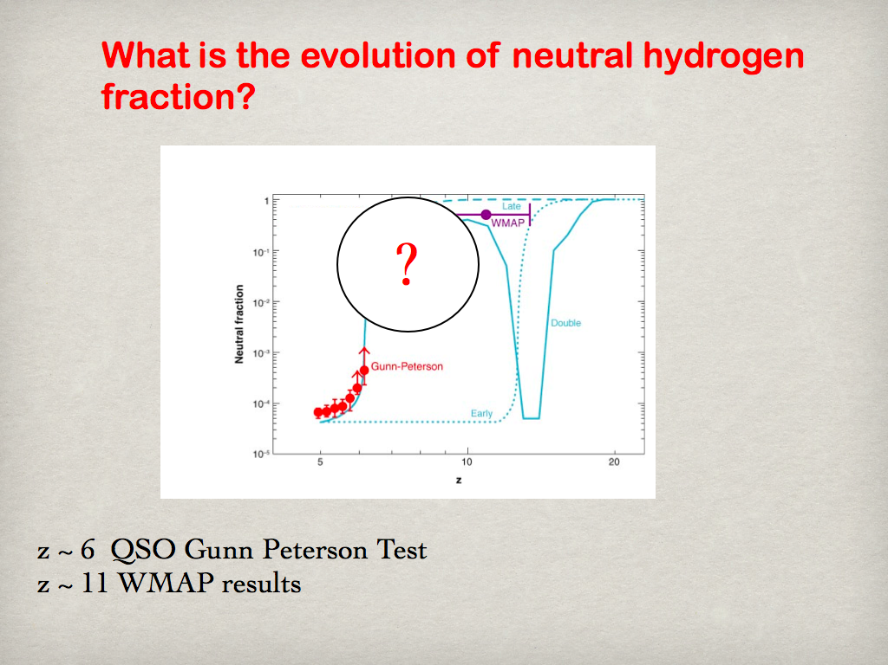
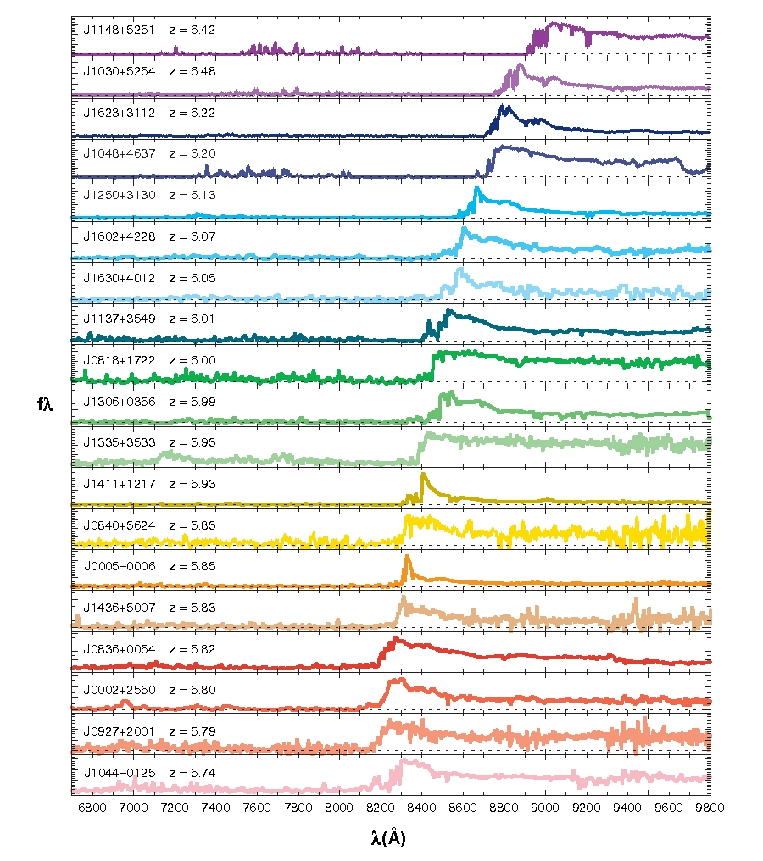
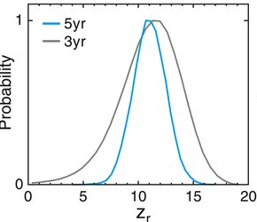
Timeline of HI Reionization Process
QSO Gunn Peterson trough :
--> IGM ionized by z~6 (e.g. Fan+06)
--> HI neutral fraction >0.1 at z~7 from QSO
ULAS J1120+0641 (Mortlock et al. 2012,
Bolton et al. 2012)
WMAP τ_{es} :
Reionization at z≈10
(Komatsu+09)
(z>6.7 if instantaneous, Dunkley+09)

Slide 5
Timeline of HI Reionization Process
QSOs at z=7 are extremely rare (Mortlock et al. 2011)
In the entire UKIDSS survey only 3 such QSO were found
Moreover they probably lie in very biased region of the Universe ( being the most massive objects observed at each epoch) hence they might not tell us about general ionization conditions
Use Lyα emitters and Lyman break galaxies as potential probes of neutral fraction in the IGM
These objects are 1. more numerous
2. probe “normal” galaxy population
3. probe common conditions in the early Universe

Slide 6
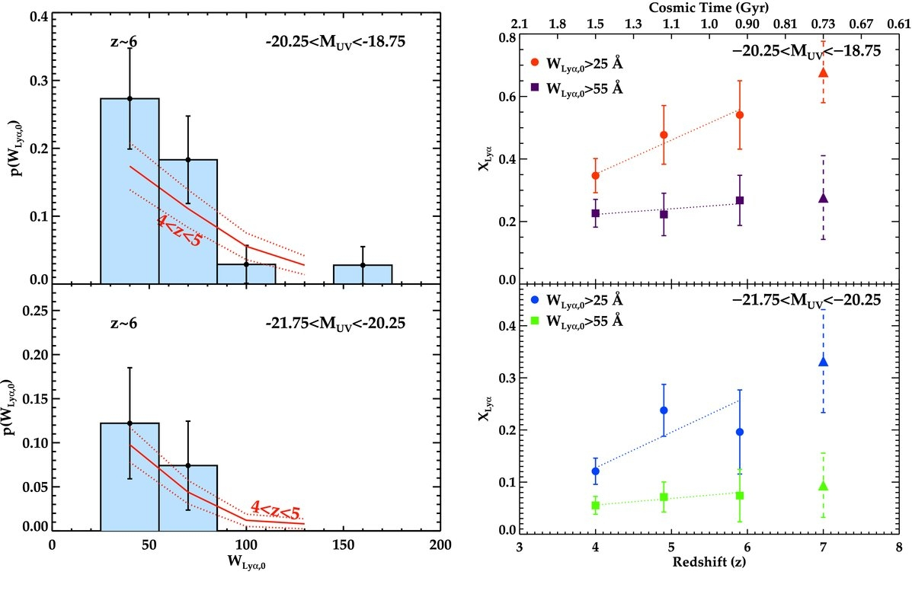
Evolution of the fraction of strong Lyα emitters in samples of Lyman Break Galaxies
RATIONALE: The Lyα emission should be present in all young star forming galaxies: it is quenched mainly by dust within the galaxies (although the final transmission is due also to the escape fraction, the presence of outflows etc)
As we go to higher redshift we observe a steady and marked increase of the
fraction of Lyα emission amongst LBGs (from z=2 to z=6) : this is an indication that galaxies become on average younger and contain less dust hence have stronger Lyα (Stark et al. 2010 with data from Vanzella et al. 2009/2010 Stanway et al. 2009 + others)
Left: the differential rest-frame Lyα EW distribution, p(W_{Lyα}) (computed in bins spanning ΔW_{Lyα,0} = 30 Å) for star-forming galaxies at z 6 in two luminosity ranges (–21.75 < M_{UV} < –20.25 on bottom and –20.25 < M_{UV} < –18.75 on top). Overplotted in red is the Lyα EW distribution for LBGs at 4 < z < 5 . Right: evolution in the overall fraction of Lyα emitters (X_{Lyα}) in the LBG population over 4 < z < 6. Luminous LBGs are in the bottom panel, fainter systems in the top panel

Slide 7
As we probe earlier epochs, we should get to a point where the Universe becomes partly neutral: since the Lyα line is easily suppressed by even a small amount of neutral hydrogen we expect to detect a lack of Lyα emission is star forming galaxies (selected as LBGs) provided that the galaxies properties do not change significantly over the redshift range ≈6 to 7
Advantages of using Lyman Break Galaxies as reionization probes over Lyα emitters
✓ Being a fraction it is not subject to number density
evolution
✓ LBGs have measurable continuum colors (contrary
to the majority of LAEs) therefore galaxies’s properties
e.g. dust obscuration can be tracked independently

Slide 8
Searching for z～7 galaxies with a deep Hawk-I survey
HAWKI science verification data + ESO LP (HAWKI + FORS2)
Total ∼160 Hours of VLT time (see Adriano’s talk)
Fields with
excellent complementary multi-wavelength coverage
3 independent fields to beat cosmic variance
Total area surveyed = 200 arcmin sq
BDF 4
GOODS-SOUTH
NTTDF

Slide 9
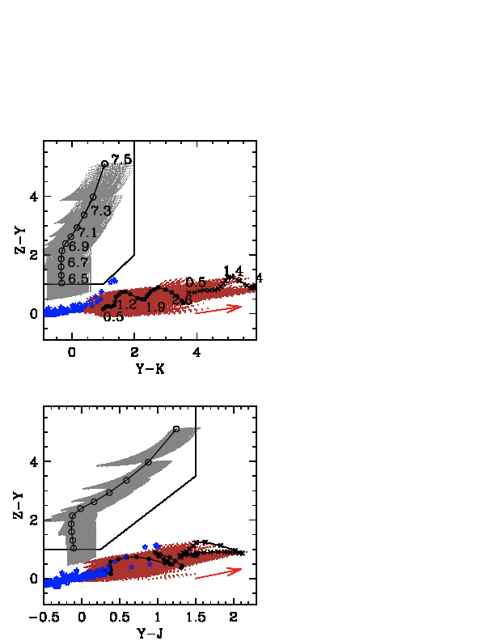
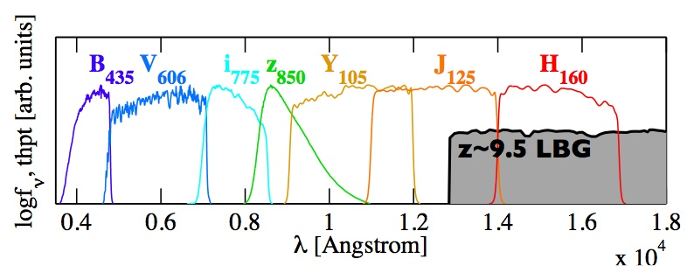
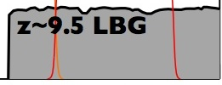
Selection of Lyman break galaxies at z=7
Z ~7 LBG
A LYMAN BREAK GALAXY AT Z ~7 WILL HAVE A SHARP
DROP IN COLOR BETWEEN THE Z AND Y BAND
(ALSO CALLED Z-DROPOUTS)
IF WE PLOT ITS COLORS IN A Z-Y VS Y-K (OR Y-J)
DIAGRAM IT WILL OCCUPY A VERY DISTINC REGION
AND WILL BE EASILY DISTINGUISHED FROM ALL
OTHER LOWER REDSHIFT GALAXIES AND STARS

Slide 10
Samples of z=z candidates in the GOODS-SOUTH field
Very deep optical data are required to get rid of interlopers
STACK OF ALL CANDIDATES

Slide 11
z∼7 candidates with Hawk-I: BDF4 and NTTDF field

Slide 12
Our Hawk-I survey was designed from the beginning to allow efficient spectroscopic follow-up:
VLT Ultradeep spectroscopy
20 targets in 3 fields
45hr with red-enhanced FORS2
(15hr/target)
EXTENDED
MORPHOLOGY!!

Slide 13
Emission lines show typical asymmetry expected for Lyα
EW =50-60Å
L ∼ 10⁴² erg/s/cm²
SFR (Lyα) ∼ 5-10 M⦿ /yr

Slide 14
Two z∼7 galaxies in the BDF4 field
Separated by 4.4Mpc (proper)
Apparently these galaxies are not luminous enough to produce their surrounding HII bubbles
the intrinsic SFR is much higher than what we measure (e.g. if suppressed by dust)
BUT...no evidence for dust. Possible evidence for a very steep UV slope, from limits in H and K band (HAWKI data). Deeper WFC3 images are needed to determine the slopes.
2. There are surrounding fainter galaxies
that contribute to the reionization background
(clustering enhancement e.g. )
Predicted number of fainter galaxies around BDF521 and BDF3299 that surround an HST like
field of view and would contribute to ionizing the HII bubble where our galaxies reside
(semi-analytical models of P. Dayal). Deep HST exposures would be needed to detect them
(or wait for JWST)

Slide 15
Final sample: combination of 3 fields GOODS-S + NTTDF +BDF4
Targets: 20 high quality candidates
5 confirmed redshifts 6.7<z<7.1
Only 2 with EW>50Å
1 confirmed interloper at lower redshift (z=5.8)
In addition, many i-dropout used as slit fillers were confirmed at z~6, including several faint continuum-only objects (with Lyman break)→ interloper rate is below 20%
(Pentericci et al. 2011)

Slide 16
First indications for a decline in the fraction of Lyα emitters
in LBGs at redshift above 6
Stark’ s high z predictions
Stark lower z
(Pentericci et al. 2011)
Our observations

Slide 17
Estimating the probability of detecting so few Lyα
Assumptions:
1) All z-drops are at z~7 / 20% of undetections are interlopers
2) Redshift distribution of z-drops as given by simulations

Slide 18
Estimating the probability of detecting so few Lyα
Assumptions:
1) All z-drops are at z~7 / 20% of undetections are interlopers
2) Redshift distribution of z-drops as given by simulations
3) Distribution of Lyα EW does not change from z=6 to z=7 and is determined from Stark et al. (2010) + Vanzella et al (2009) sample
➡

Slide 19
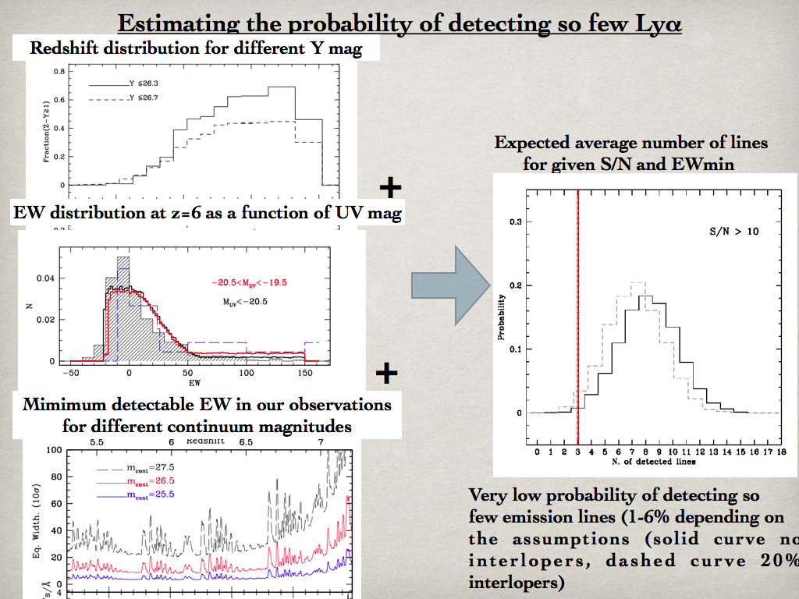
Very low probability of detecting so few mission lines (1-6% depending on the assumptions (solid curve=no interlopers; dashed curve=20% Interlopers)

Slide 20
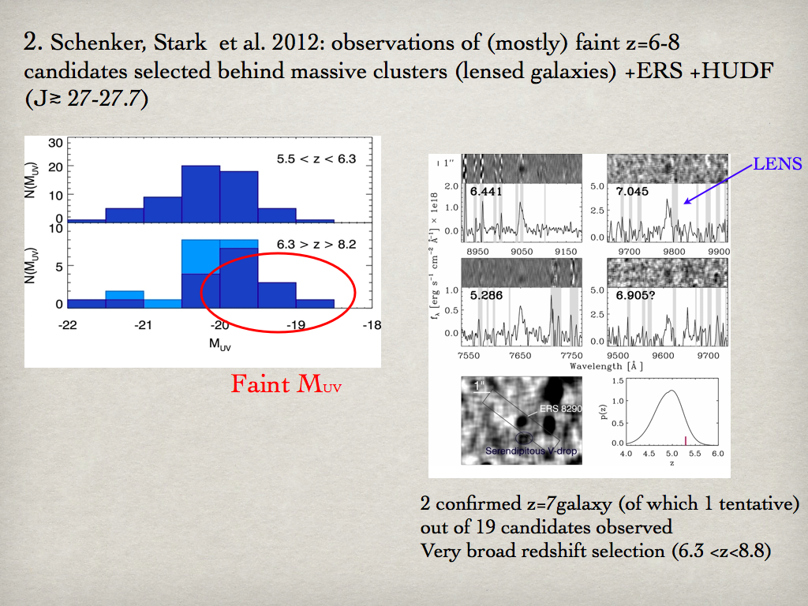

Slide 21
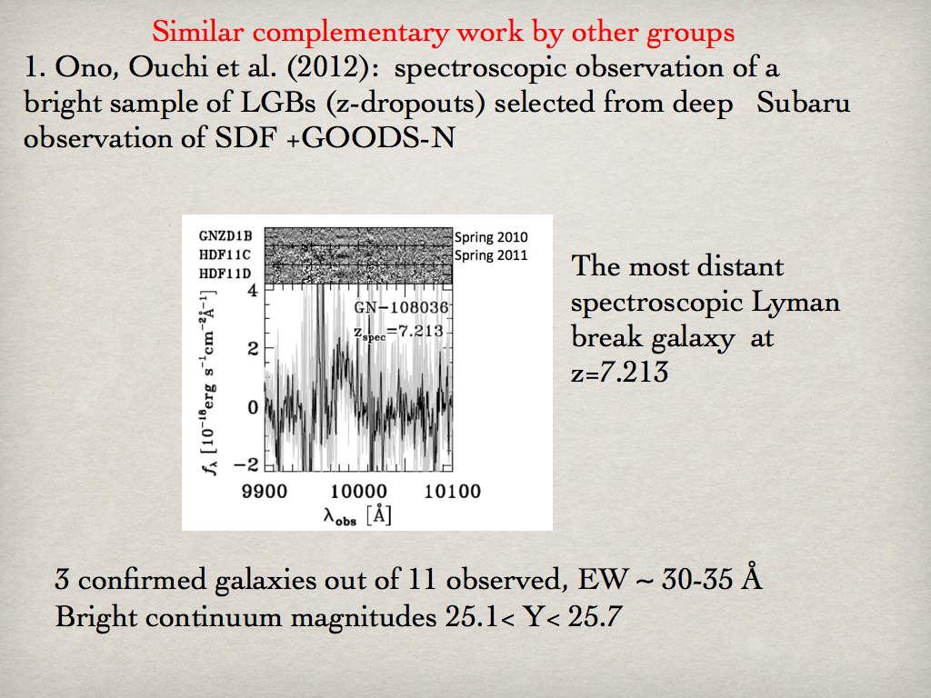

Slide 22
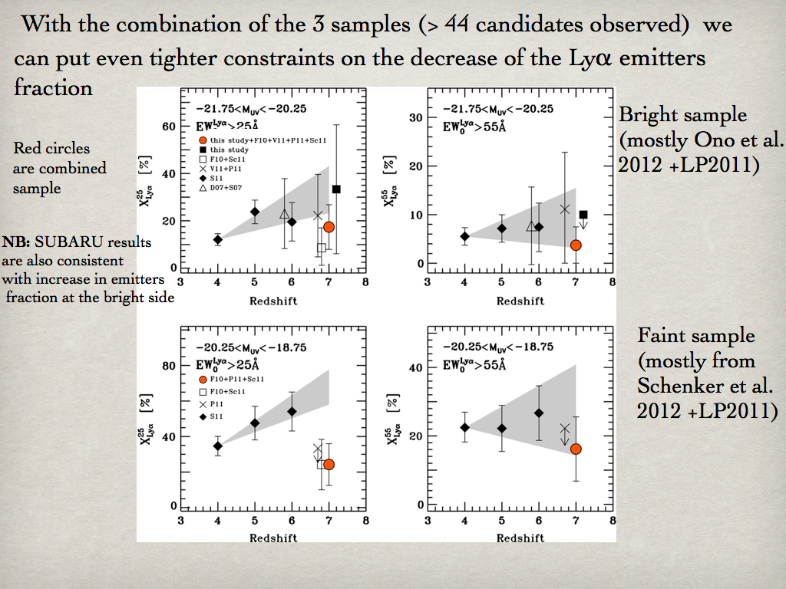

Slide 23
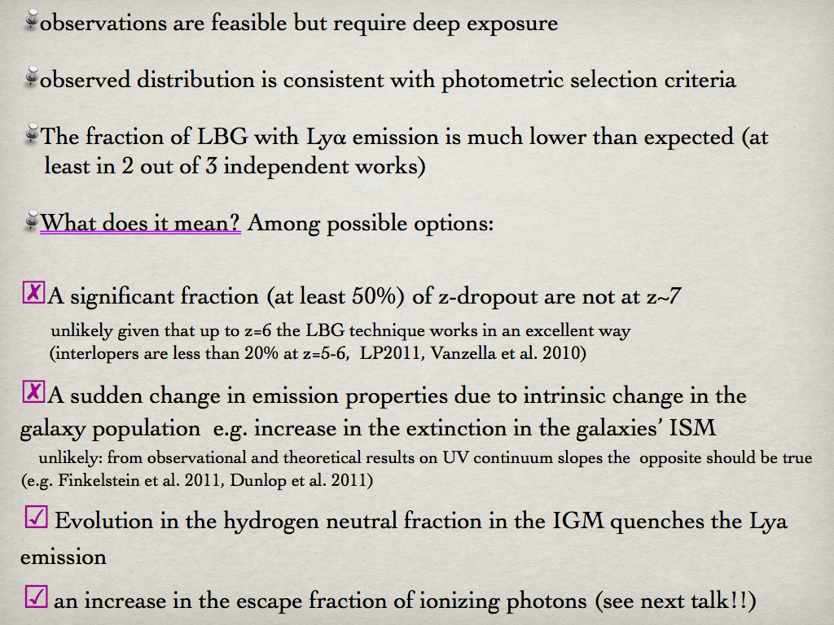

Slide 24
Is Lyα quenched by neutral hydrogen??
The amplitude of the drop seems to be more pronounced
for fainter galaxies that for brighter ones (although samples
of fainter galaxies is considerably smaller)
--> this might suggests that reionization proceeded inside-out

Slide 25
Setting constraints on the neutral hydrogen fraction
We employ he models developed by Dijkstra & Whyite (010) which couple large
scale semi-numeric simulations of reionzation with galaxies outflows,
Assumptions – the Universe is completely ionized by z=6
- the escape fraction of LyC photons remains unchanged
- the EW distribution at z=6 is modeled as an exponential function
that matches that of Stark et al 2010)
- the halos of detected LBGs have 10¹⁰ M < m_{halo}< 3 x10¹⁰
- no dust
Variables
Outflowing wind velocity
Neutral hydrogen fraction
(by volume)
Column density of HI
FIDUCIAL MODEL: N_{HI}=10²⁰ cm²
X_{HI} = 0.6 @z=7

Slide 26
Similar results were recently found by Jensen+2012 using a different model
that includes N body simulations+radiative transfer of ionizing rdiation+ radiative
transfer of Lyα through the IGM+Lyα line model
Results for a simple Gaussian line profile
Results for a GmG -Gaussian minus
Gaussian profle (i.e. a double peaked
line profile)
In both cases data require a large X_{HI} > 0.5 @z=7
Also assumes the Universe is completely ionized at z=6 and galaxies properties do not evolve

Slide 27
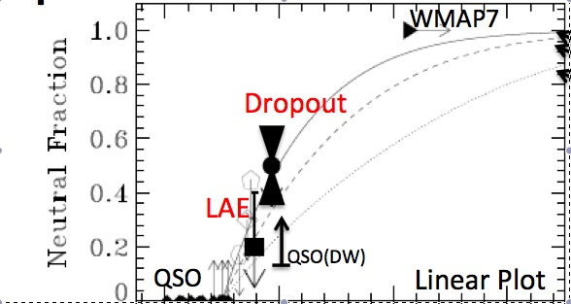
Summary of results from LBGs and LAEs
observations
Includes also results from the evolution of LAEs luminosity function and LAEs clustering
between z≈5.7 and z≈6.5
Lyα fraction in LBGs X_{HI} = 0.6 @z=7
LAEs LF X_{HI} ≤ 0.2 @z=6.6
LAEs clustering LF X_{HI} ≤ 0.5 @z=6.6
Lyα line shape X_{HI} ≤ 1.0 @z=6.6

Slide 28
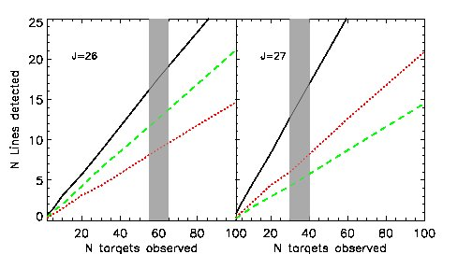
WHAT’S NEXT?? WITH A MUCH LARGER (≈100 ) AND HOMOGENEOUSLY SELECTED SAMPLE OF LBGs WE CAN PROBE NOT ONLY THE TIMELINE OF REIONIZATION BUT ALSO MEASURE THE TOPOLOGY OF THE REIONIZATION PROCESS
Adopting the model
of Treu et al. 2011 for smooth/patchy reionization
Predicted detection rates for z= 7 galaxies as a function of sample size for various continuum flux. Grey area shows the size of a CANDELS selected sample of z ≈7 galaxies. The mean number of detections depends both on the average opacity of the IGM (the ε parameter) and on the patchiness of the reionization process: (1) ε= 1 i.e., Lyα distribution as at z=6 (black solid); (2) patchy reionization with ε_p= 0.5 (green dashed), i.e., half the emitters as at z= 6; (3)smooth reionization with ε_s = 0.5 (red dotted, i.e. half of the luminosity).
Observing samples at different fluxes allow us to break the degeneracy between ε and the patchiness and hence measure the topology of the reionization process.

Slide 29
CONCLUSIONS
*Spectroscopic observations of Lyman Break Galaxies and Lyα emitters are a powerful tool to probe the epoch of reionization
*LBGs and LAEs provide complementary and independent estimates of the neutral hydrogen fraction in the early Universe
*With observations of a larger and carefully selected sample of z=7 galaxies we might start to probe also the topology of reionization
* Soon we will be able to push our work to redshift >7.3 with the advent of the near-IR MO spectrograph KMOS@VLT!!
Thank you!

