Slide 1
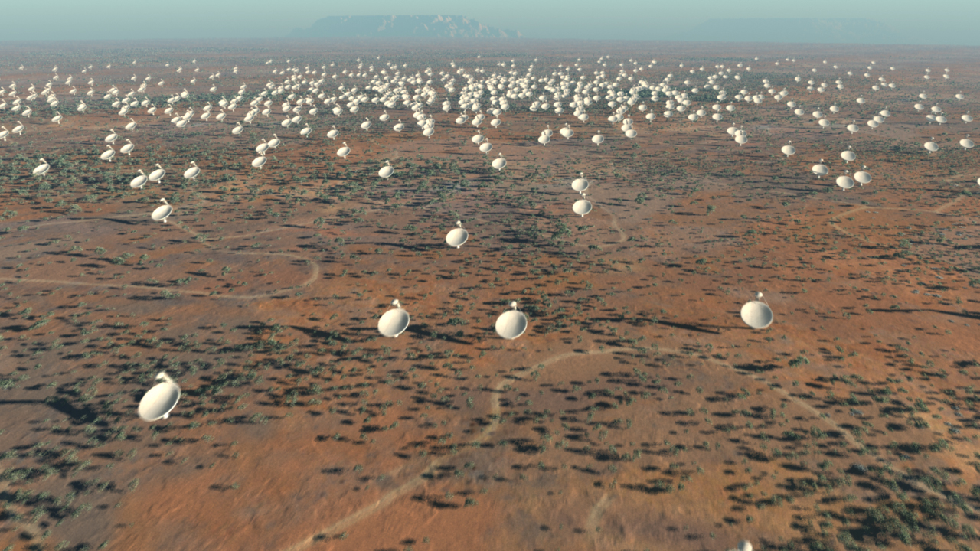


The Square Kilometre Array
Sec 1.
Lister Staveley-Smith^{1,2,3} (with thanks to Minh Huynh and Joe Lazio)
International Centre for Radio Astronomy Research (ICRAR), University of Western Australia
ARC Centre for All-sky Astrophysics (CAASTRO)
SKA Science Working Group and Pathfinders HI Survey Coordination Committee
SKA
Ischia 2011 August 29

Slide 2
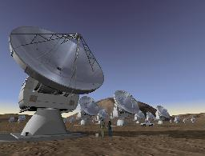
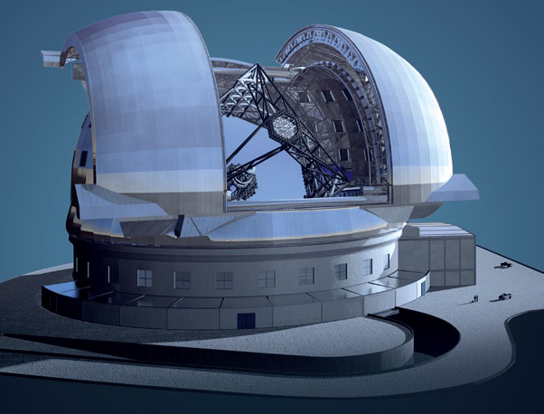
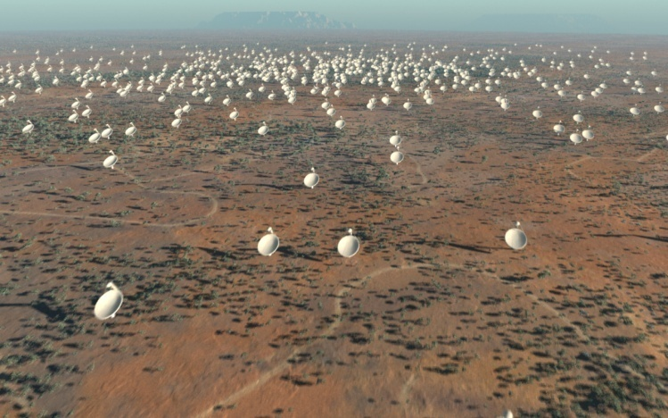
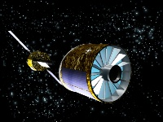
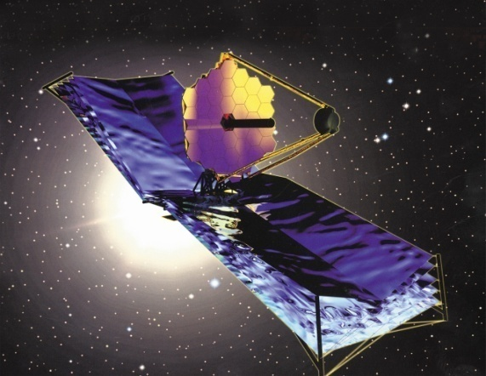
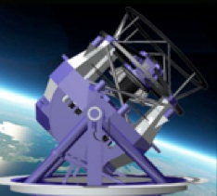
Great Observatories for the coming decade
ALMA
E-ELT
SKA
IXO
JWST
LSST

Slide 3

European Astronet Roadmap
Identified E-ELT and SKA as highest-ranked large ground-based facilities for astronomy
ISBN 978-3-923524-62-4
de Zeeuw & Molster

Slide 4
Key E-ELT Science and SKA synergies
E-ELT key science | Corresponding SKA science goals
Exoplanets Earth-like planets; pre-biotic material | Cradle of Life Proto-planetary disks; SETI
Fundamental Physics Dark energy; fundamental constants | Galaxies, Cosmology and Dark Energy Dark energy; fundamental constants
Black Holes Testing GR at the Galactic Centre | Pulsars, GR and Gravitation Testing GR; detecting gravity waves
Birth, Life and Death of Stars Stellar evolution and archeology | (formation of massive stars; AGB mass-loss; supernovae remnants)
Stellar Content of Galaxies Star-formation history of the Universe | Galaxies, Cosmology and Dark Energy Gaseous evolution of the Universe
End of the Dark Ages The first stars | Probing the Dark Ages and the EOR Bubbles around the first galaxies; first AGN
Discovery potential The unexpected | Exploration of the Unknown The transient radio universe

Slide 5
SKA Technical Specifications Snapshot
Wavelength (Frequency) | 2 cm–4 m (0.07 – 10+ GHz)
Sensitivity | A_{eff}/T_{sys} ~ 10000 m²/K (10 nJy rms, 1000 h, continuum)
Field of view | 1 deg² or larger @ 1 GHz 100 deg² @ 0.1 GHz
Survey speed | ~ 10¹⁰ deg² m⁴ K⁻² (100 Gpc³ survey of H I to z > 1.5)
Baselines | 3000km+ max (dishes) 80% of dishes within 180km radius 50% of dishes within 2.5km radius 20% of dishes within 0.5km radius
Resolution | 30 arcmin (0.5 km, 4 m) to 1 milliarcsec (3000 km, 2cm)
Α
Α²Ω

Slide 6
SKA Phased Roll Out
Construction will proceed in two phases, Phase 1 and Phase 2.
Phase 1 will be 10% of the full SKA.
  sparse aperture arrays operating at 70 MHz to 450 MHz
  about 250 15m dishes operating between 450 MHz and 3 GHz
Advanced instrumentation program
  Phased Array Feeds (e.g. ASKAP/APERTIF), Mid Frequency (Dense) Aperture Arrays (e.g. EMBRACE), Ultra wide-band Single Pixel Feeds (e.g. ATA feeds)
Major science will be possible with SKA1 in 2020

Slide 7
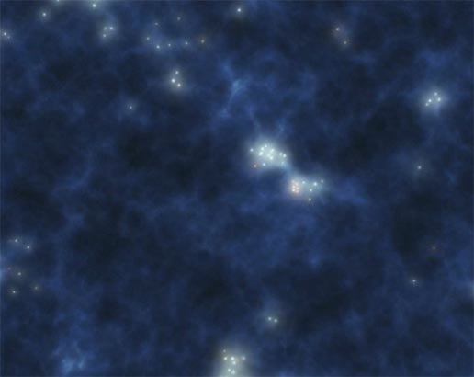
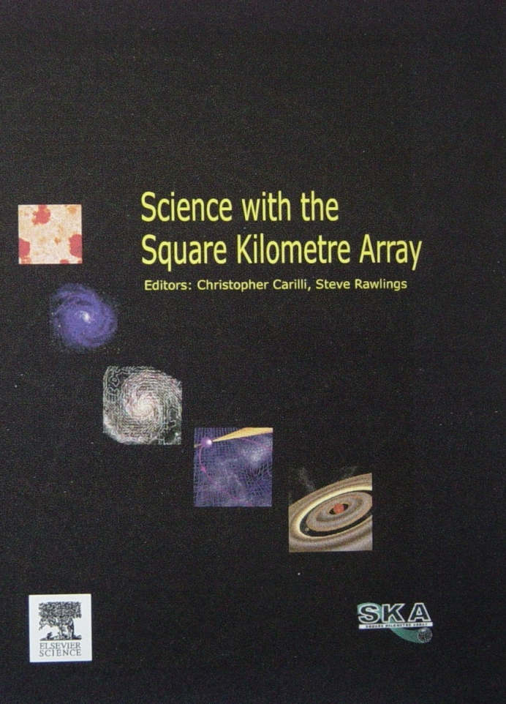
SKA Key Science Drivers
ORIGINS
Probing the Dark Ages and the Epoch of Reionization
  - EoR, first galaxies and active galactic nuclei
Galaxy Evolution, Cosmology, and Dark Energy
  - When did the first stars and galaxies form?
  - How did galaxies evolve?
  - Dark Energy, Dark Matter
Cradle of Life
  - Organic molecules in interstellar space and proto-planetary disks
  - SETI
FUNDAMENTAL FORCES
Pulsars, General Relativity & Gravitational Waves
Origin & evolution of cosmic magnetism
EXPLORATION OF THE UNKNOWN
Transients and new phenomena
Science with the Square Kilometre Array
(2004, eds. C. Carilli & S. Rawlings, New Astron. Rev., 48)

Slide 8
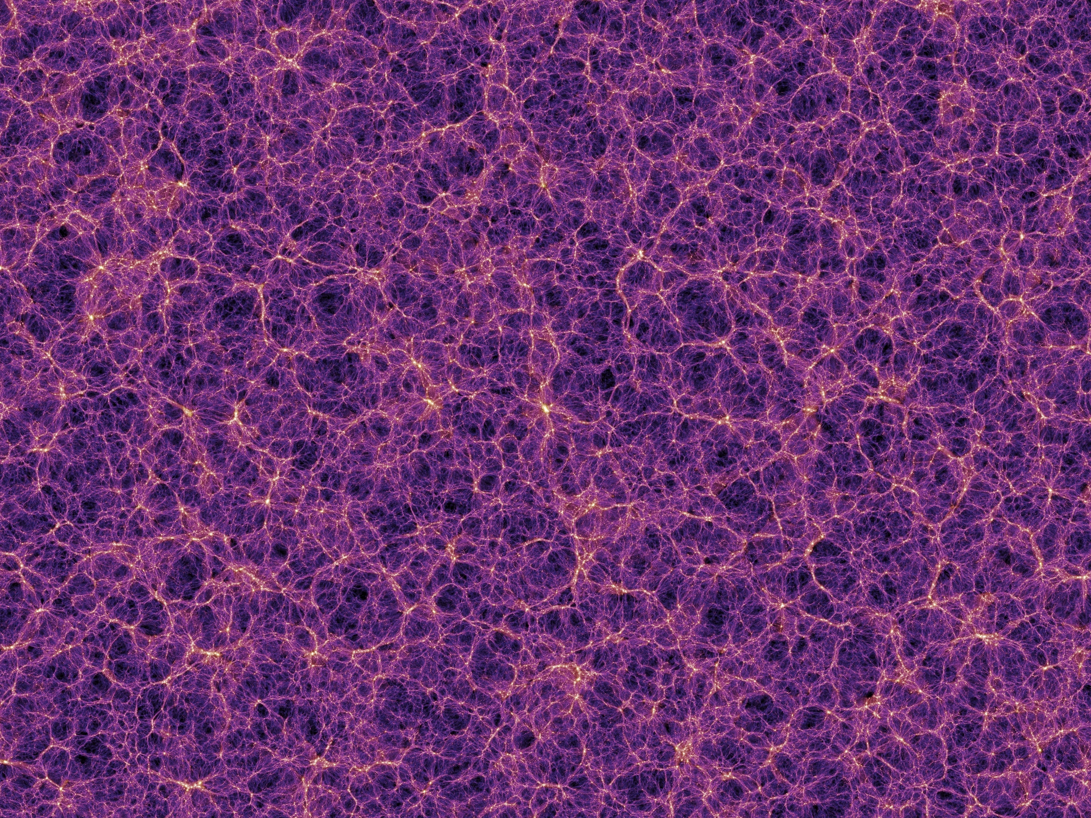
Galaxy Evolution, Cosmology and Dark Energy
What is the equation of state of dark energy?
What is the efficiency of gas accretion onto galaxies at different epochs?
How do baryons affect the distribution of dark matter?
How does AGN feedback affect the growth of galaxies?
What is the relative role of thermal, magnetic and CR pressure?
How does gas content vary with redshift and environment?

Slide 9
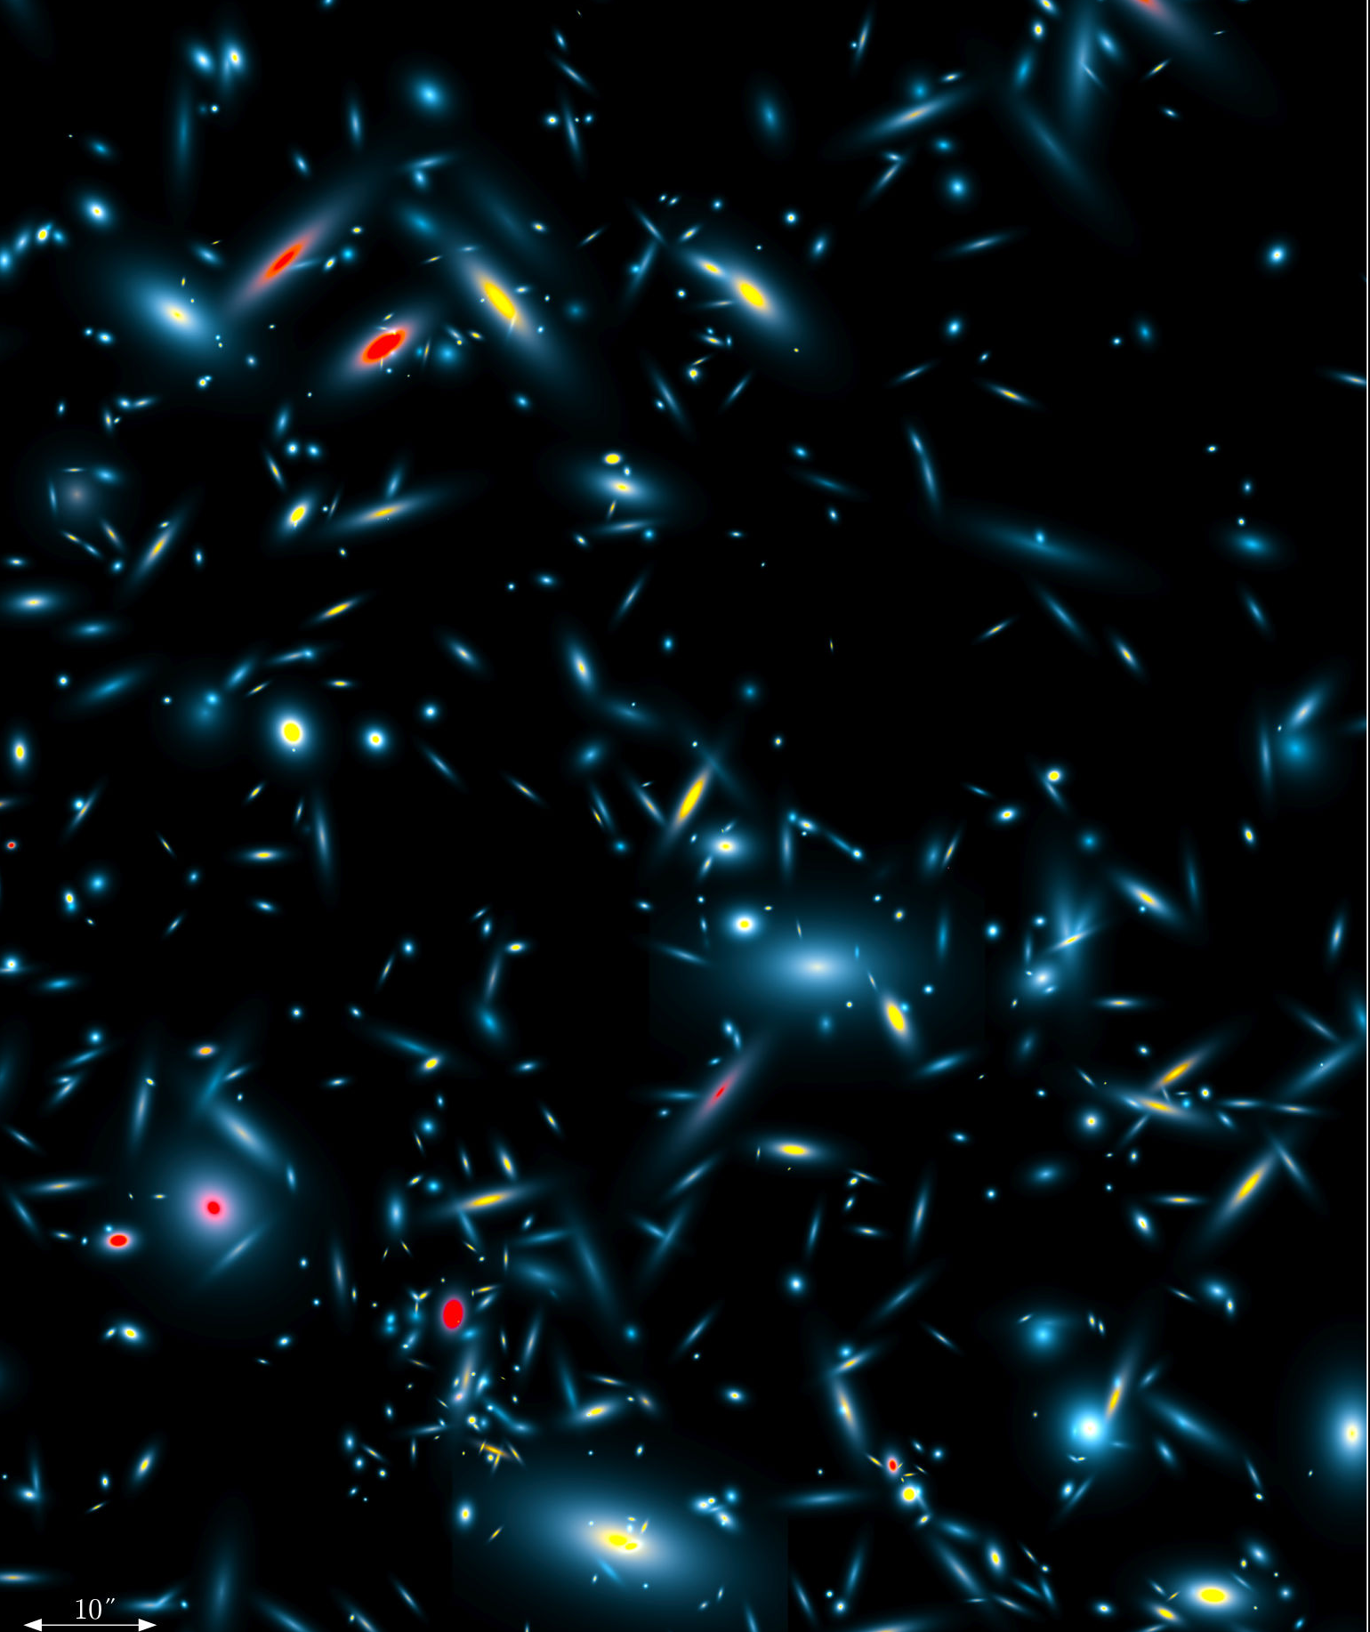
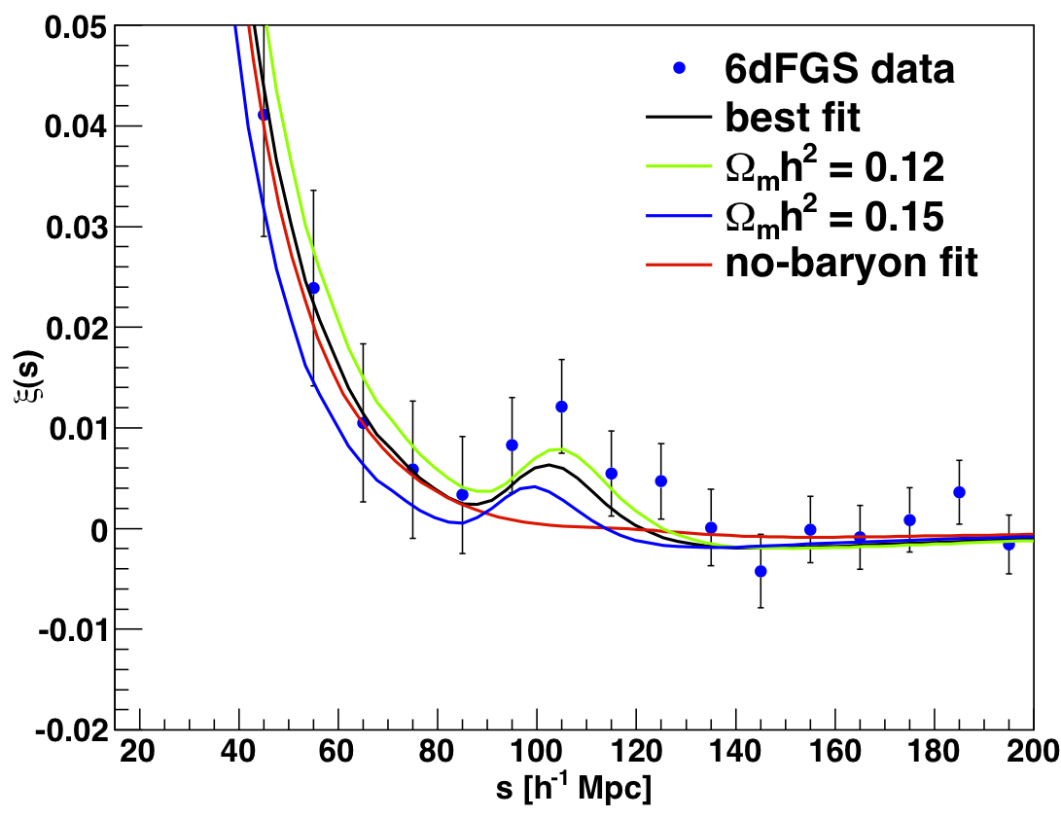
Cosmology and Sky Surveys
SKADS Simulated Radio Sky
Image the sky, locating galaxies
  Analysis of locations compared with cosmological models to constrain parameters
Two broad classes of surveys
  Continuum: e.g., NVSS, FIRST, ASKAP/EMU, WSRT/APERTIF/WODAN, MeerKAT/MIGHTEE
  Spectroscopic: SDSS, Arecibo ALFALFA, ASKAP/WALLABY, SKA H i survey
    Spectroscopic surveys locate in 3-D space! very powerful
Ultimate goal: spectroscopic survey of 1 billion galaxies
Beutler et al. (2011) detection of BAOs in 6dFGS

Slide 10
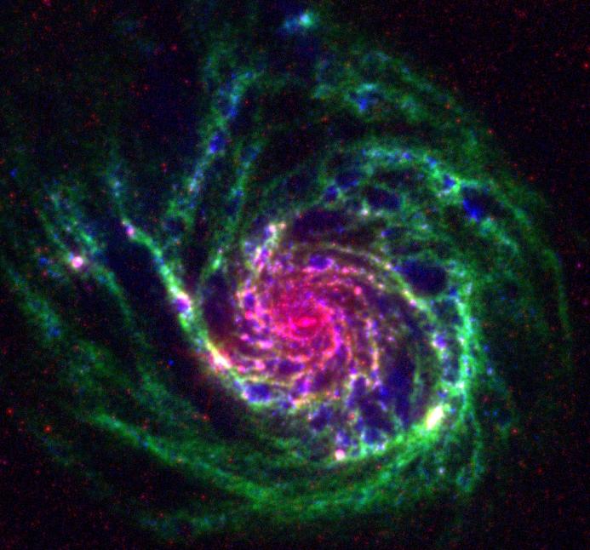
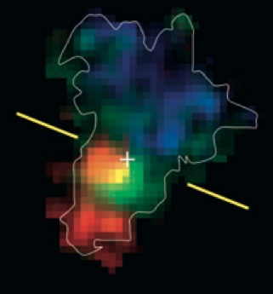
Galaxy Assembly
Stars and Gas
Neutral hydrogen (HI) is the raw material for galaxies and star formation
  How do galaxies get their gas?
  Smooth accretion .v. hierarchical merging
  Cold .v. hot mode
  How do galaxies turn gas into stars?
  How does gas content vary with density, redshift, environment?
Need observations of gas content —over cosmic time—to understand galaxy formation!
M101 HI/UV/IR VLA/GALEX/Spitzer (Walter/THINGS)

Slide 11
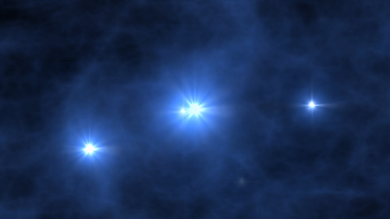
Probing the Dark Ages and the Epoch of Reionization
Imaging the transition from a neutral to an ionised IGM
What reioinizes the Universe at the end of the dark ages?
When does reionization end and how quickly did it proceed?
How quickly did supermassive black holes form?
What is the topology of the ionised IGM; how sharp are the edges around QSO HII regions?
When did the first radio sources form?
Notes:
ionisation sources: dwarf galaxies; giant galaxies; UL X-ray sources; Pop III stars; AGNs

Slide 12
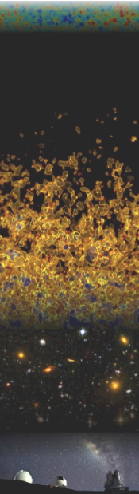
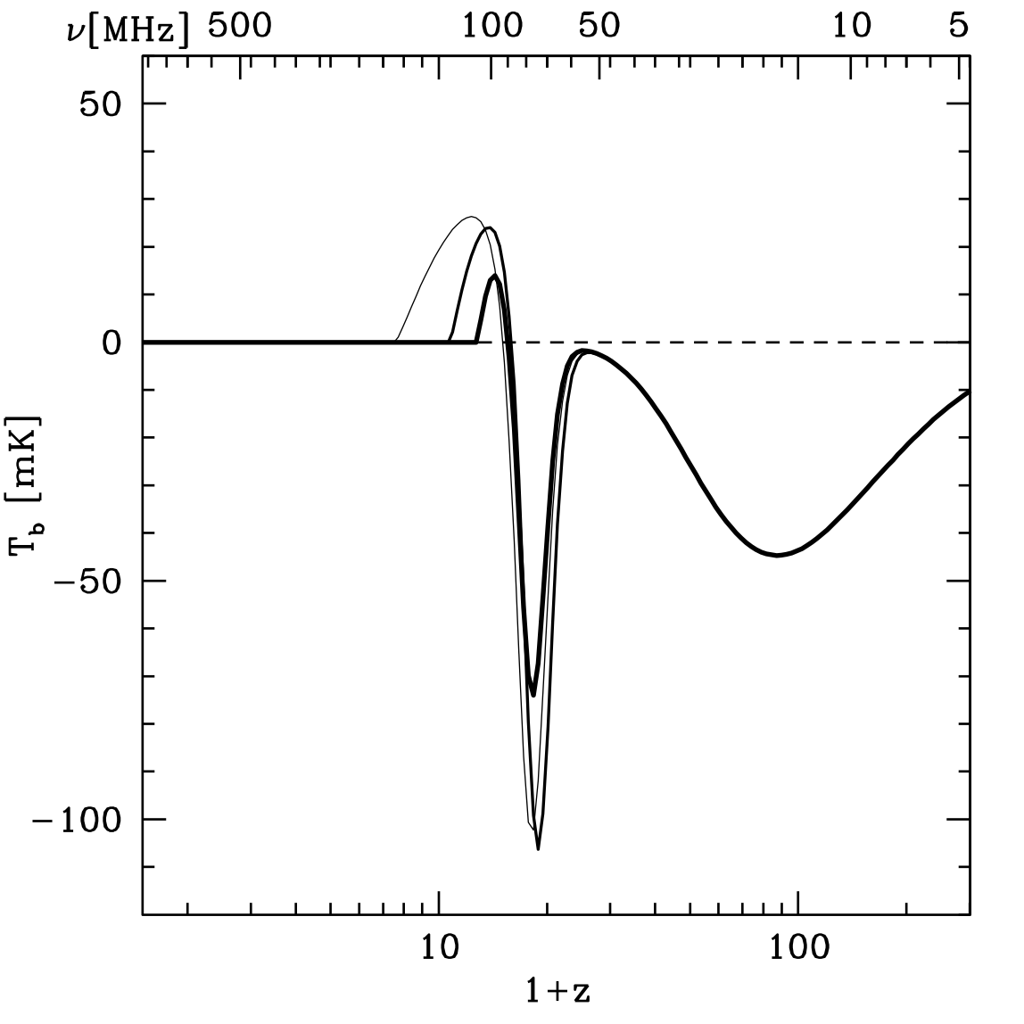
Evolution of the Universe
H I brightness temperature signal (w.r.t. CMB)
X-ray heating, EoR
First Stars
Dark Ages
SKA
space?
(Pritchard & Loeb 2008)

Slide 13
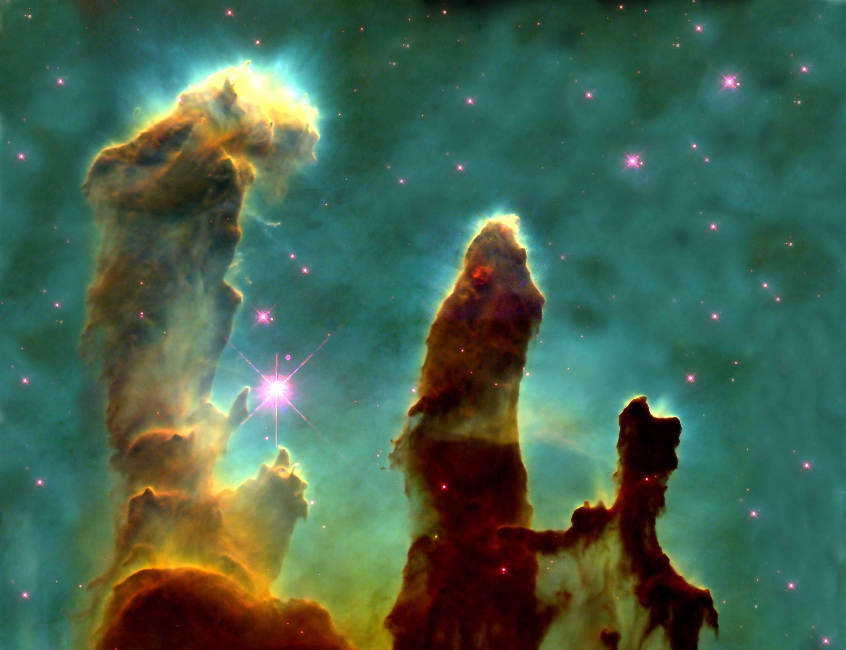
Astrobiology at Long Wavelengths
Imaging of thermal dust emission from proto-planetary nebulae
Astrochemistry of complex molecules
Prebiotic molecules
Proto-planetary chemistry

Slide 14
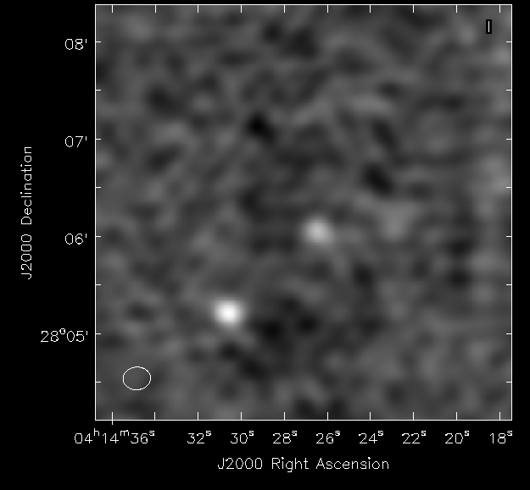
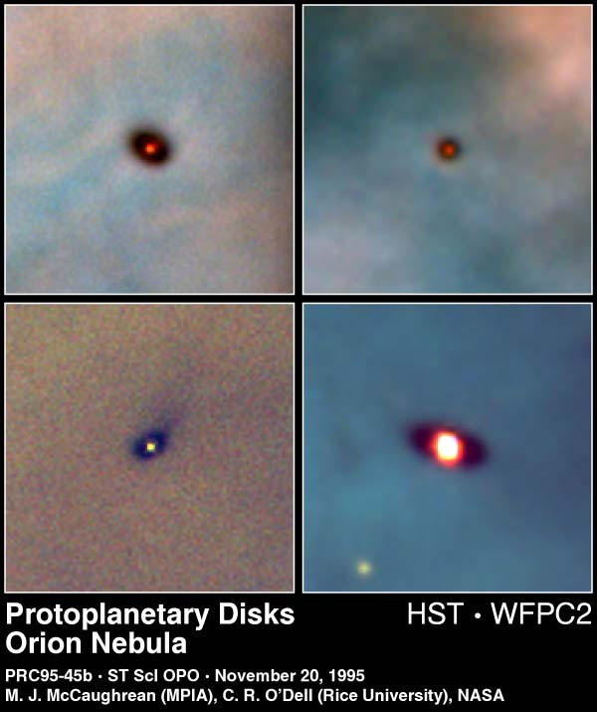
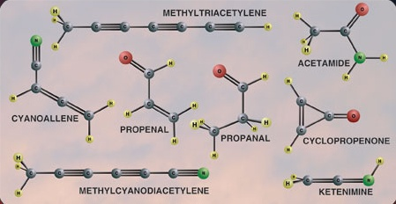
Astrobiology at Long Wavelengths
λ > 1 cm
Not affected by dust
Complex molecules have transitions at longer wavelengths
“Waterhole” (1.4–1.7 GHz)
Magnetically-generated emissions from extrasolar planets
EVLA 6 cm observations of protoplanetary disks
Complex organic molecules detected at radio wavelengths

Slide 15
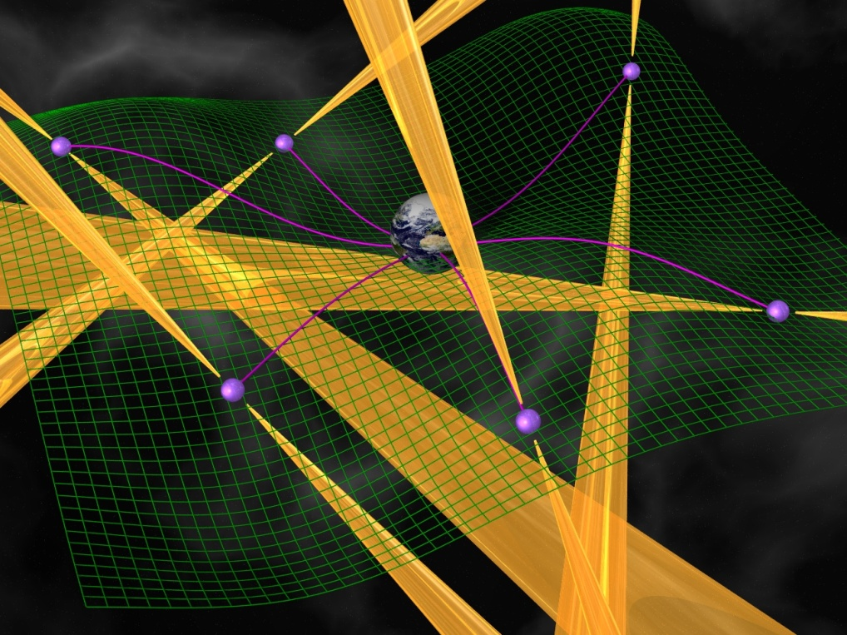
Did Einstein Have the Last Word on Gravity?
Relativistic binaries:
  Equivalence principle
  Strong-field tests of gravity
  Black hole-neutron star binaries?
Direct detection of Gravity Waves:
Pulsar timing array
LIGO: suspended masses
LISA: freely falling mirrors

Slide 16
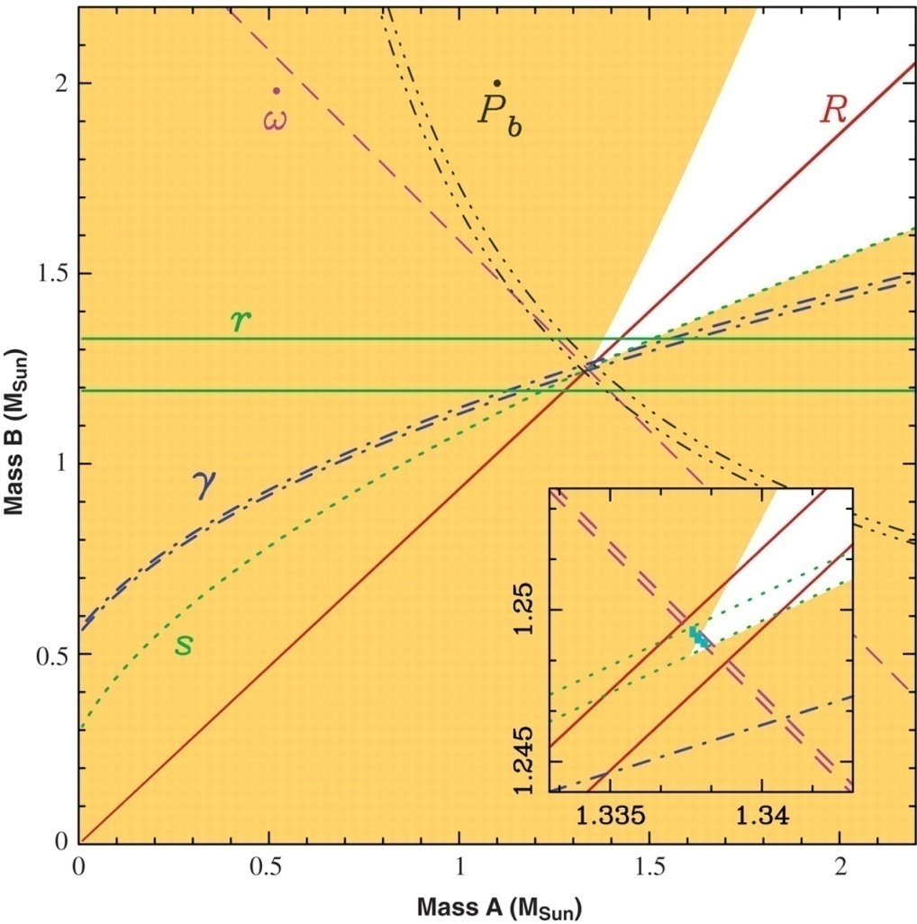
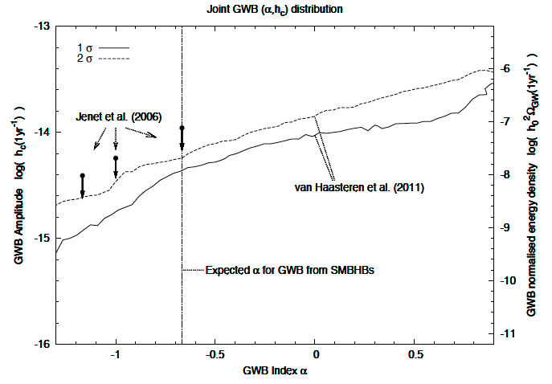
SKA: Gravitational Wave Detector
Relativistic binaries probe:
  Equivalence principle
  Strong-field tests of gravity
Black hole-neutron star binaries?
“Planets” (Bailes et al. 2011)
Pulsar timing arrays starting to provide results from ensemble of pulsars:
EPTA (van Haasteren et al., above)
PPTA (Yardley et al.)
NANOGrav (Demorest et al.)

Slide 17
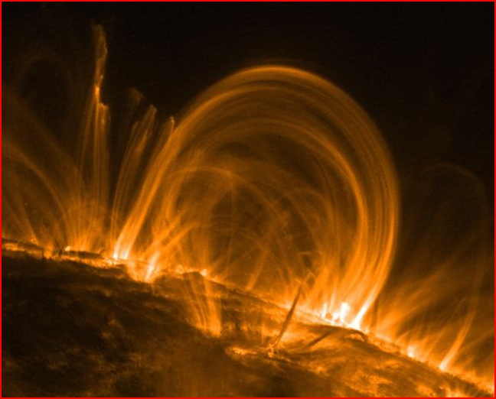
Cosmic Magnetism
How are magnetic fields generated and maintained?
How do magnetic fields evolve as galaxies evolve?
What is the strength and structure of the magnetic field of the intergalactic medium (IGM)
Are magnetic fields in galaxies and clusters primordial or generated at later epochs?
What is the efficiency of cosmic ray acceleration in the warm-hot intergalactic medium?

Slide 18
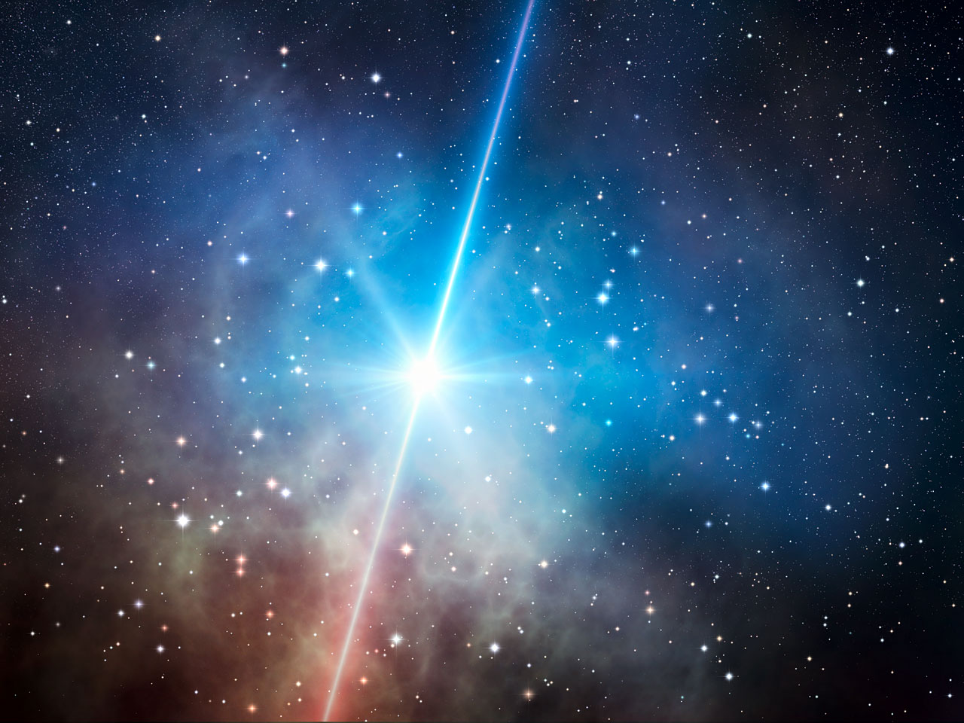
Exploration of the Unknown
Are there new physical phenomena?
Gamma Ray Bursts/Hypernovae/Supernovae/Neutron stars
What is the frequency of strong radio emission from sub-stellar objects?
Are there other detectable civilisations?

Slide 19
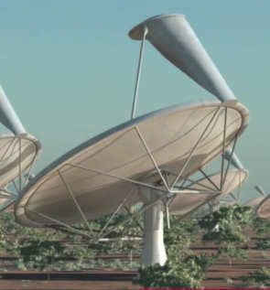
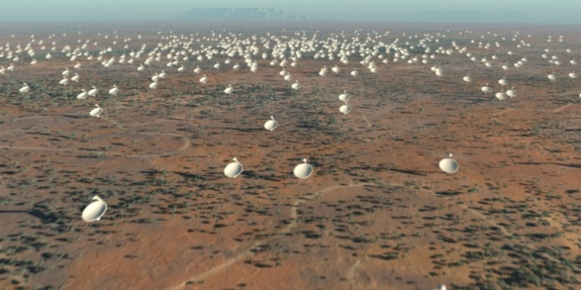
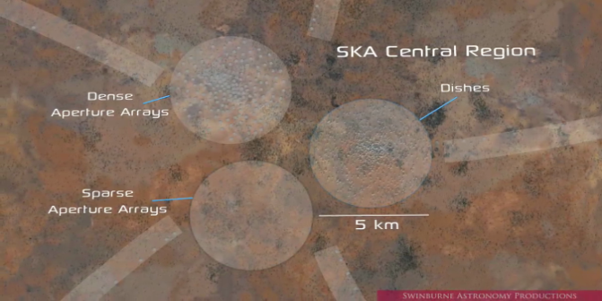
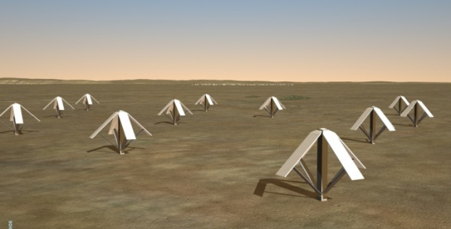
Phase 1 (SKA1) baseline design
250 Dishes
Single pixel feed
Central Region
50 Sparse Aperture Array Stations
Swinburne Astronomy Productions

Slide 20
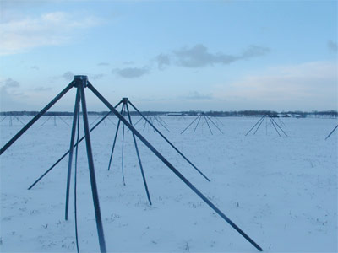
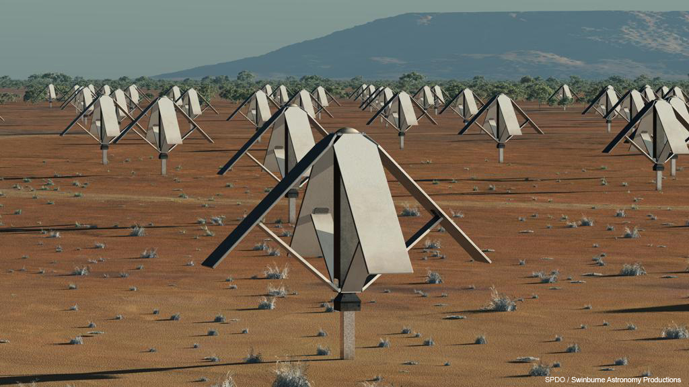
Sparse Aperture Arrays
Omnidirectional dipoles
No moving parts.
Cheap!
LOFAR
SKA

Slide 21
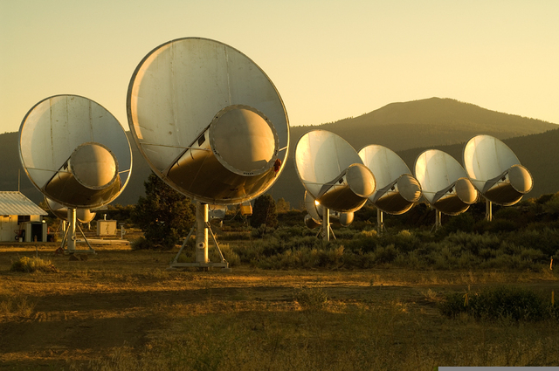
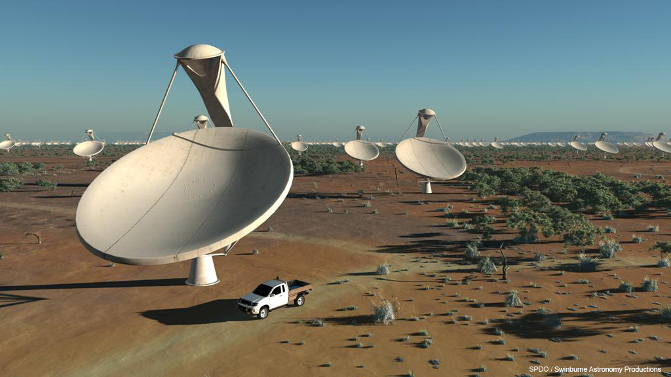
Dishes
15m offset Gregorians
Allen Telescope Array
SKA

Slide 22
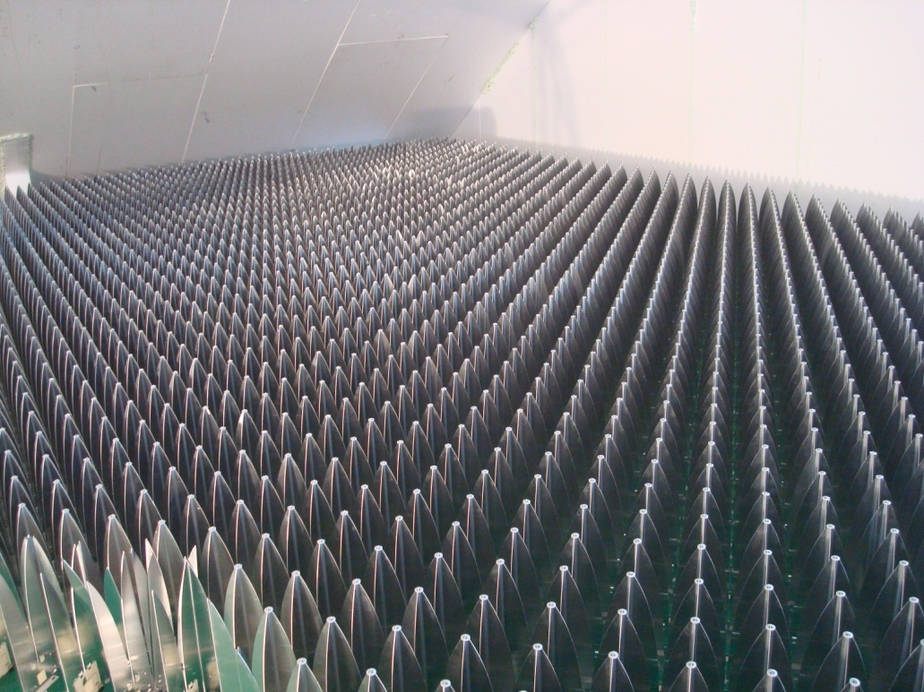
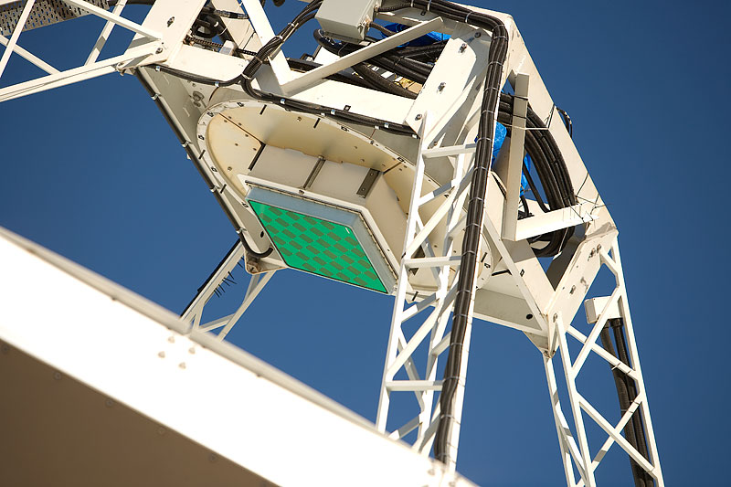
Advanced Instrumentation Program (AIP)
Phased Array Feeds
analogous to CCDs in optical
e.g. ASKAP, APERTIF
Dense Aperture Arrays
To operate ~0.5 to 1.5 GHz
e.g. EMBRACE

Slide 23
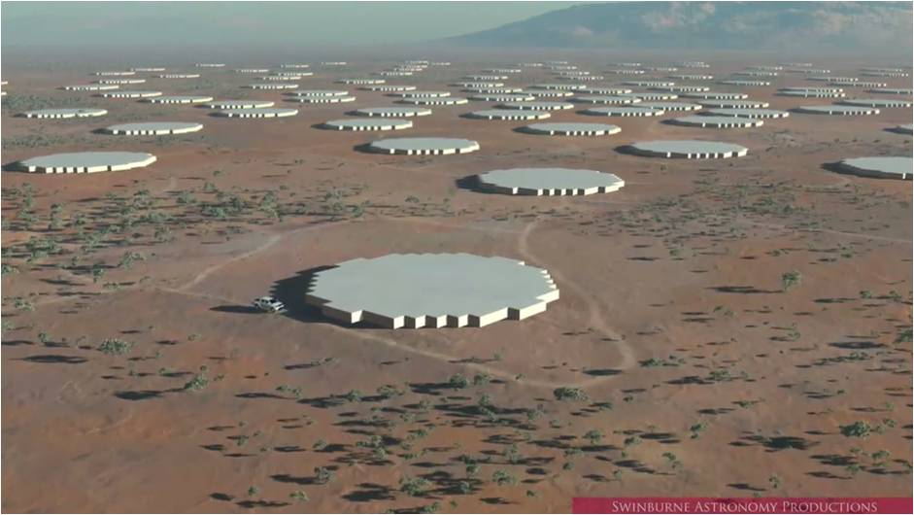
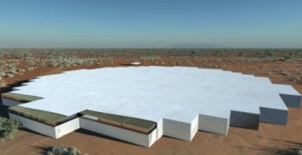
SKA2 including AIP technologies
3-core central region
250 Dense Aperture Array Stations
3000 Dishes
WBSPFs
250 Sparse Aperture Array Stations
Phased Array Feeds
Swinburne Astronomy Productions

Slide 24
SKA compute path (Cornwell/CSIRO)

Slide 25
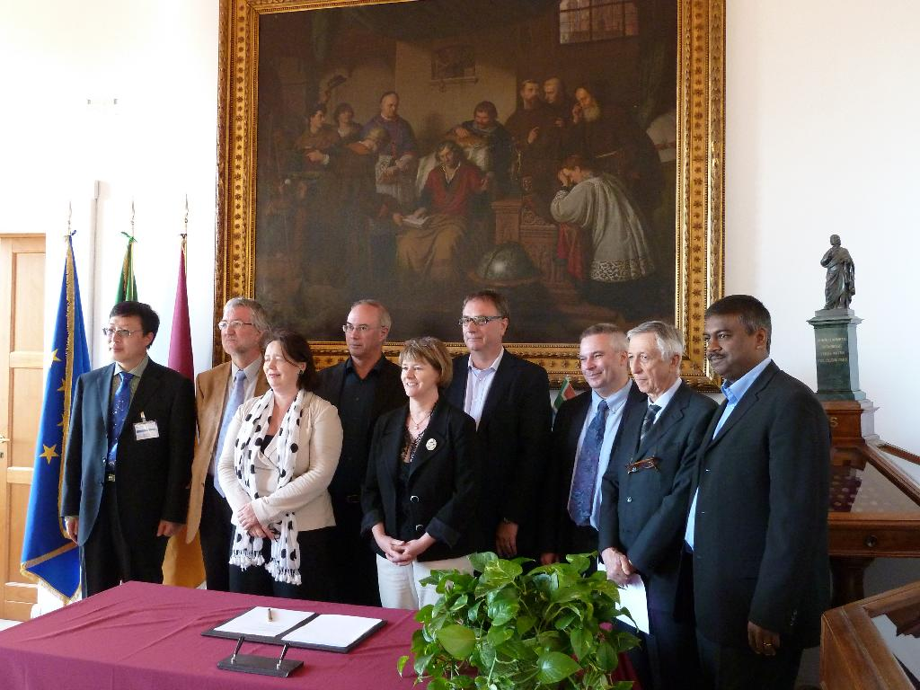
SKA: project updates
Australia, China, France, Germany, Italy, the Netherlands, New Zealand, South Africa, and the UK sign a Letter of Intent declaring their common ambition to see the SKA built.
Financial commitments of about 15M€ for SPO itself and about 81M€ for overall pre-construction phase
  Many of the commitments are in kind or in effort, rather than in cash
SKA Project Office (SPO) will be located at Jodrell Bank Observatory, near Manchester, England.

Slide 26
Site Selection
Two candidates shortlisted in 2006
Western Australia and South Africa
Physical Requirements
Extremely radio quiet environment
At least 3000km in extent
Low ionospheric and tropospheric turbulence
Timeline:
Information from sites to be submitted Sept 2011
SKA Site Advisory Committee (SSAC), independent panel of experts, make evaluation and recommend a site by Dec 2011
Governing Board of SKA to make site selection by end of Feb 2012

Slide 27
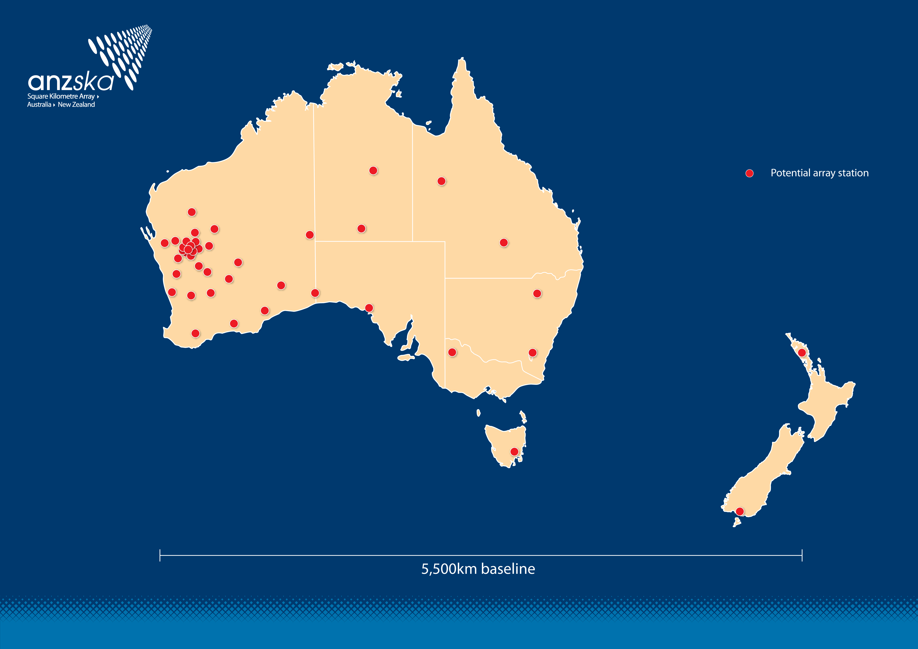
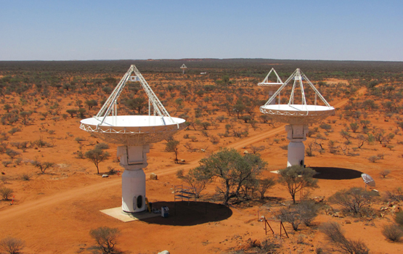
Australia and New Zealand
Credit: Ant Schinckel (CSIRO)

Slide 28
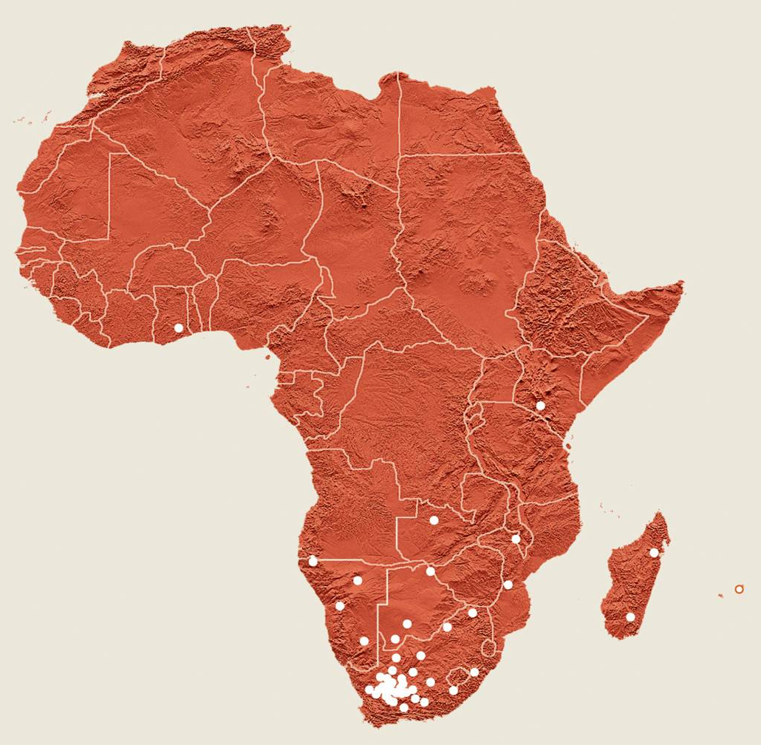
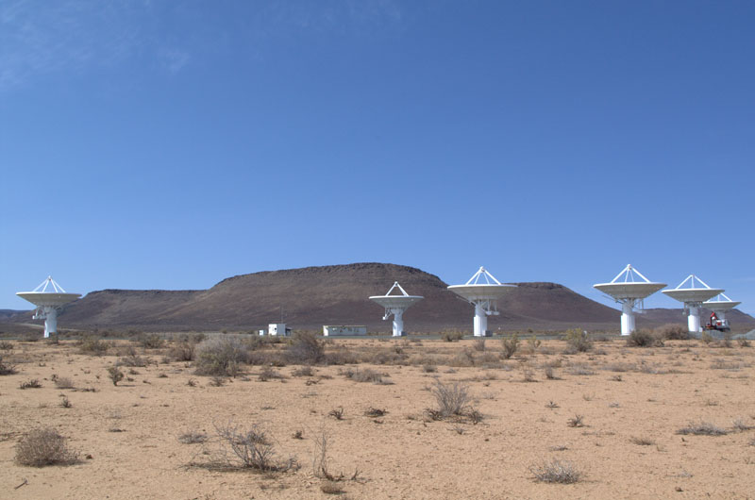
South Africa + 8 countries

Slide 29
Top level schedule for the SKA
Technical
2008-2012 telescope system design and cost (preparatory phase)
2013-15 detailed design & pre-construction phase
2016-19 Phase 1 construction
2016 Advanced Instrumentation Program decision
2018-23 Phase 2 construction
2020+ full science operations with Phase 1
2024-2050+ full science operations with Phase 2
Programmatic
2011 letters of intent; establish SKA organisation as a legal entity
2011 €96M committed to pre-construction Project Execution Plan
2012 SKA site selection
2014 construction funding approval for Phase 1 (350 M€, 2007)
2017 construction funding approval for Phase 2 (1.2 B€, 2007)
✔
✔
✔

Slide 30
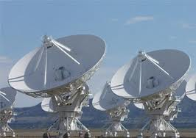
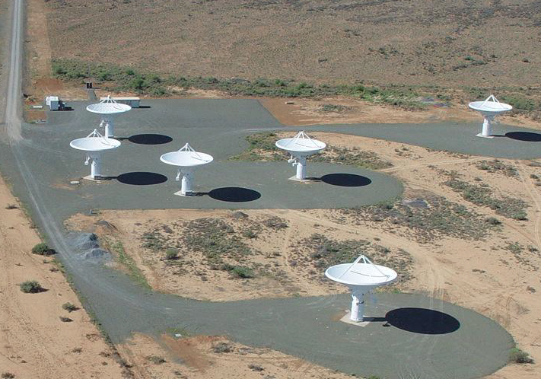


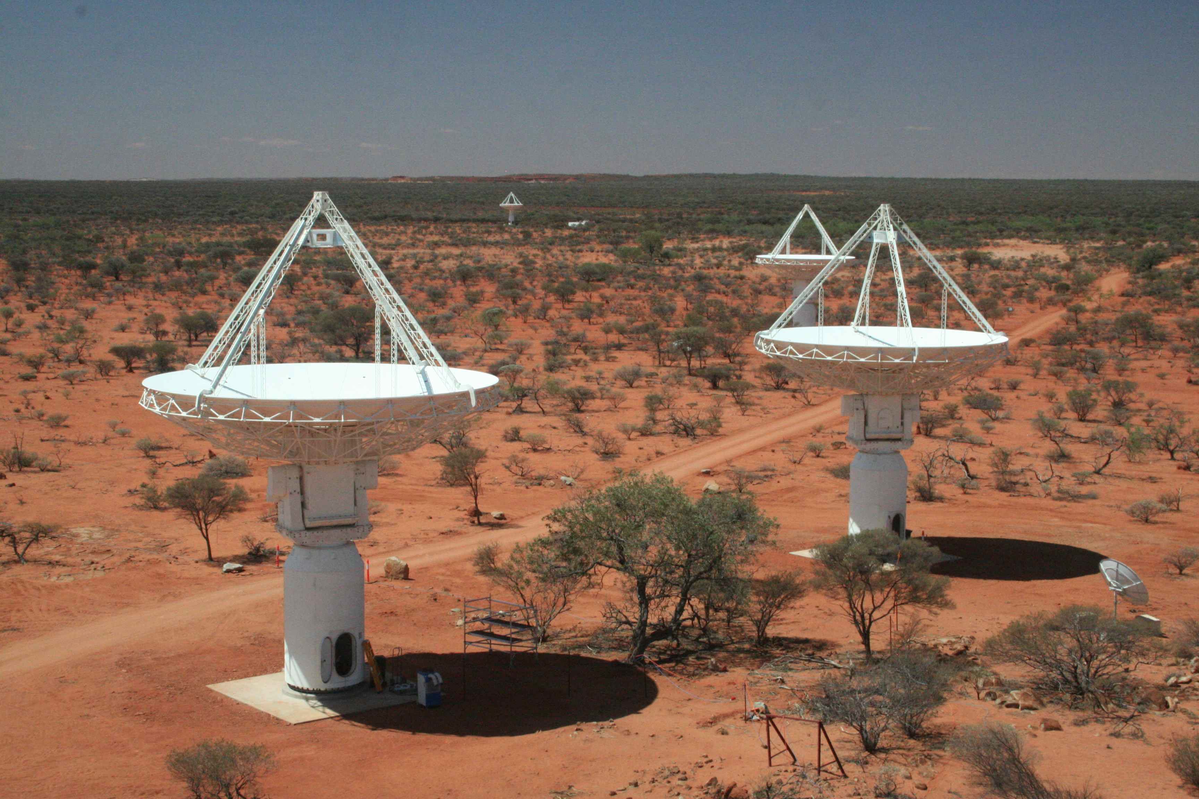
The Path to the SKA
EVLA
MeerKAT
FAST
SKA phase 2
APERTIF
NOW
2024
SKA phase 1
LOFAR
ASKAP

Slide 31
Engineering Challenges
Low cost large collecting area
Low noise, highly integrated receivers
Fast, high resolution, analogue-to-digital converters (ADCs)
Wideband optical-fibre signal transport systems (800 Tbit/s)
High performance computing (exa-flop machines required)
Data storage and retrieval (exa-byte capacity required)
Power generation (~100 MW needed to run full SKA) -> renewable energy solutions, e.g. solar

Slide 32
Summary
SKA is a transformational telescope:
  40x sensitivity of eVLA
  60,000x survey speed
A capable partner for other next-generation optical/IR facilities (E-ELT, LSST, JWST).
Ready to move into pre-construction phase on Jan 1, 2012.
In the meantime, new science capability through: LOFAR, ASKAP, MWA, MeerKAT, FAST, eVLA.

Slide 34
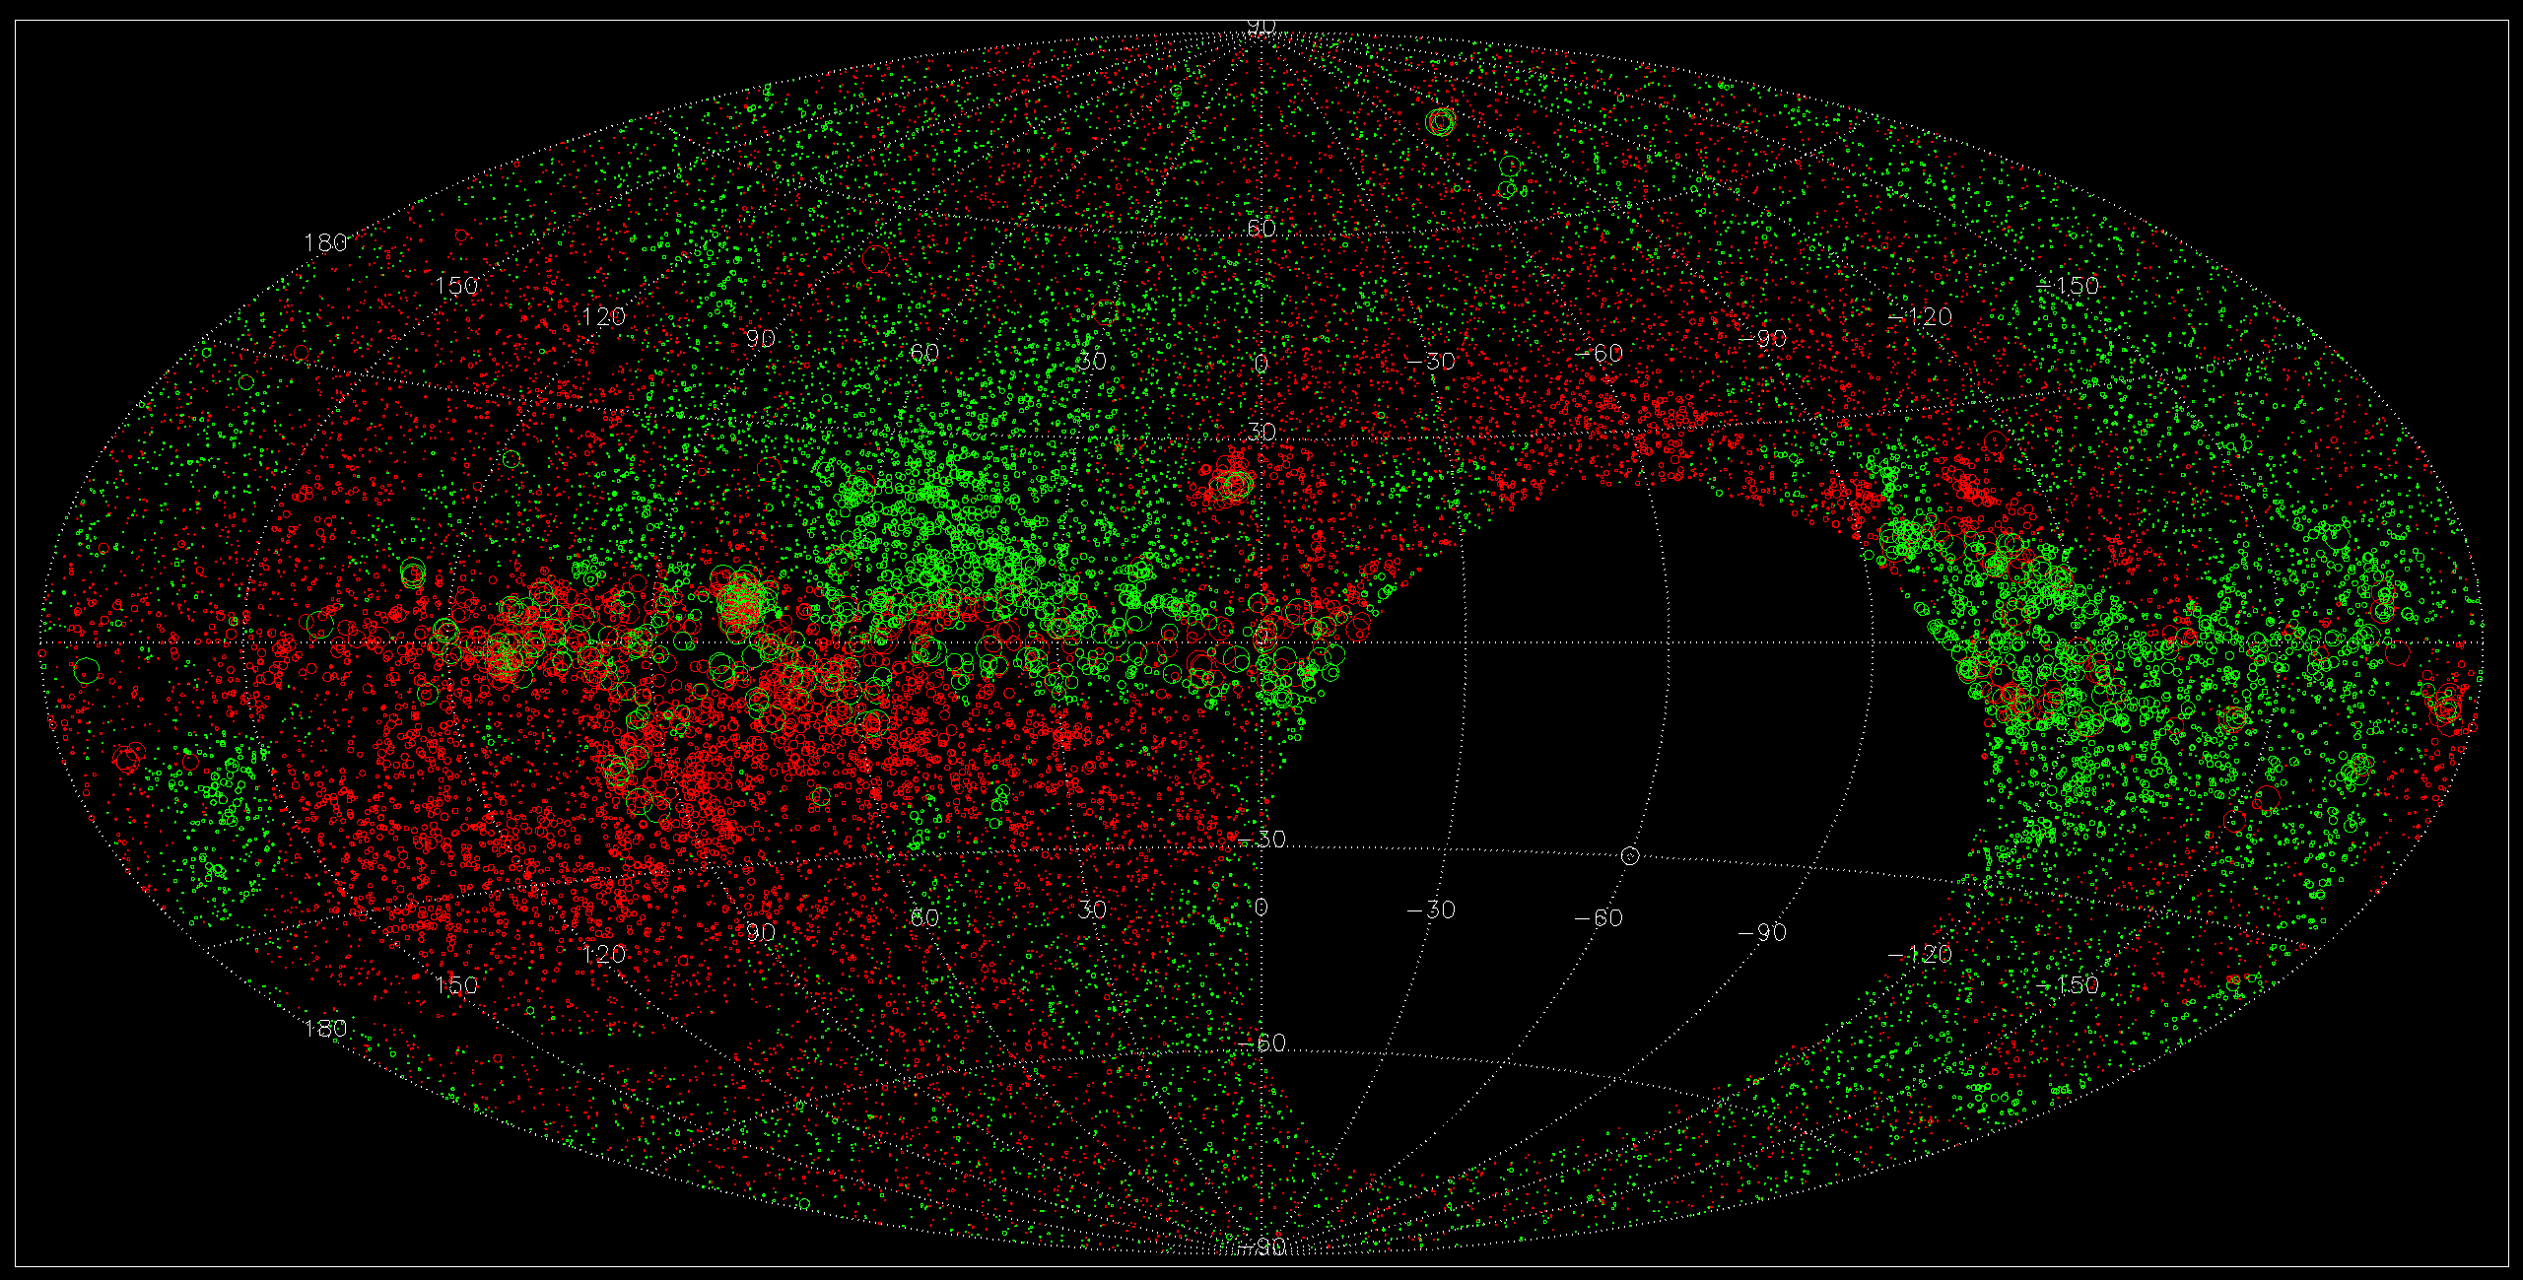
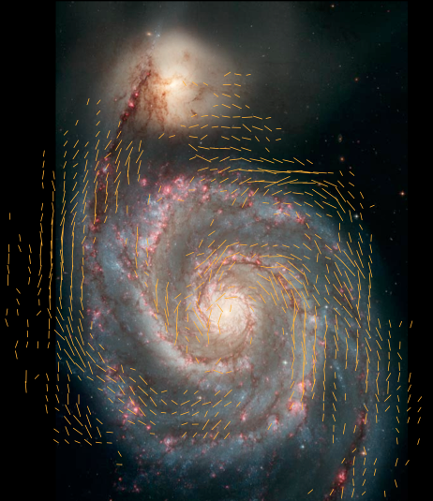
Origin & Evolution of Cosmic Magnetism
Magnetic fields are fundamental, but poorly constrained
  Affects galaxy, cluster evolution?
  Essential for star formation
  Affects propagation of cosmic rays in ISM and IGM
All-sky rotation measure surveys provide B fields along lines of sight
Continuum in I, Q, and U!
Notes:
34

Slide 35
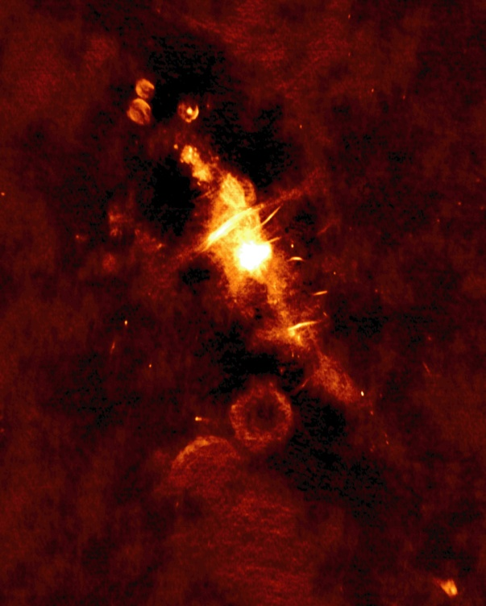
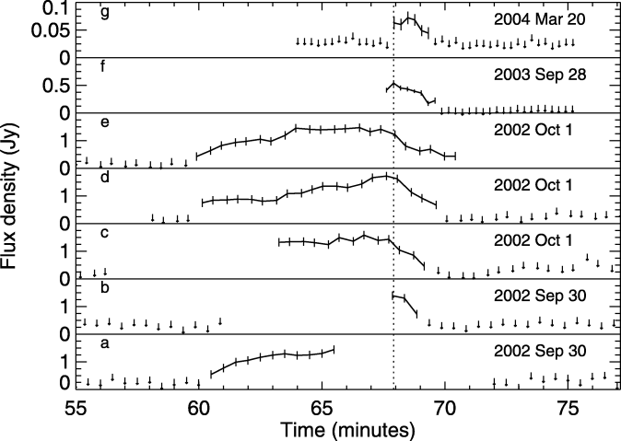



The Dynamic Radio Sky
Neutron stars
  Magnetars
  Giant pulses
  Short GRBs?
Microquasars
Tidal Disruption Events
GRBs (γ-ray loud; γ-ray quiet?)
  Afterglows
  Prompt emission?
Sub-stellar objects
  Brown dwarfs
  Extrasolar planets?
Supernovae
Scintillation
GW counterparts
UHECRs
ETI
Exploding black holes
???
Amplitude
Frequency
Time
Rotating Radio Transients (RRATS)
Pulsating Brown Dwarfs

