Slide 1
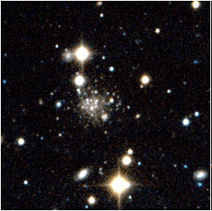
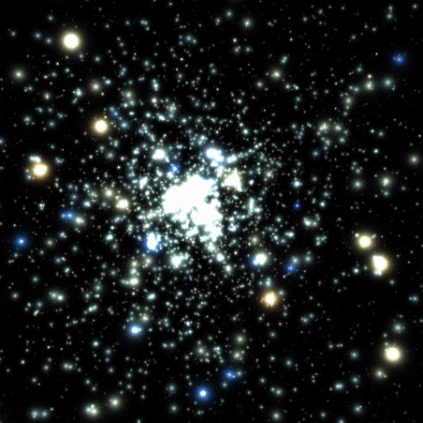
Models of Faint Galaxy Production
through Star Cluster Evolution
Jarrod Hurley (Centre for Astrophysics & Supercomputing)
“Dynamics of Low-Mass Stellar Systems”
ESO, Santiago, Chile
April 4-8 2011

Slide 2
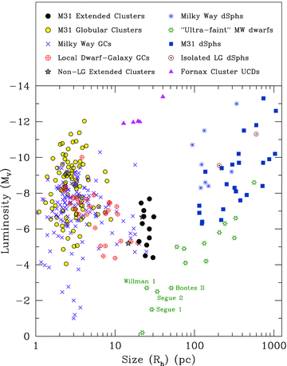
Sizes of low-mass stellar systems
Huxor+11
Models of Faint Galaxy Production through Star Cluster Evolution

Slide 3
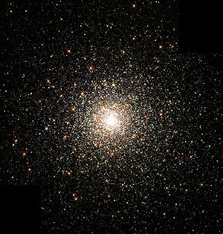
Sizes of low-mass stellar systems
MW
M31
Huxor+11
Models of Faint Galaxy Production through Star Cluster Evolution

Slide 4
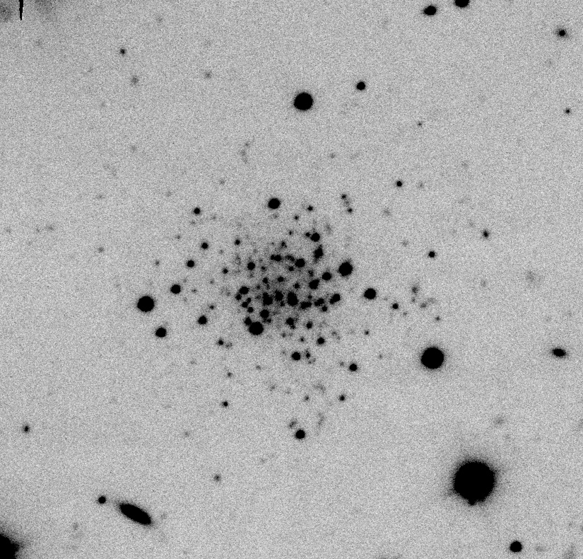
Sizes of low-mass stellar systems
MW
M31
M31
dIrr
Huxor+11
Models of Faint Galaxy Production through Star Cluster Evolution

Slide 5
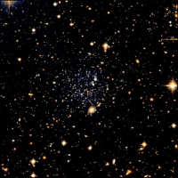
Sizes of low-mass stellar systems
MW
M31
M31
dIrr
DM halo
Huxor+11
Models of Faint Galaxy Production through Star Cluster Evolution

Slide 6
simulations of low-mass stellar systems in different tidal fields
MW
M31
M31
dIrr
DM halo
Huxor+11
Models of Faint Galaxy Production through Star Cluster Evolution

Slide 7
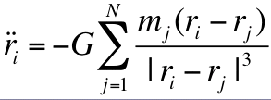
N-body simulation background
Equation of Motion
O(N³)
special-purpose GRAPE hardware
GPU
[ NBODY4/NBODY6: Aarseth 1999; Aarseth 2003]
stellar
evolution
binary
evolution
techniques
for few-body
subsystems
tidal
field
[Hurley et al. 2001] [Mardling & Aarseth 2001; Mikkola 2006, etc.]
Models of Faint Galaxy Production through Star Cluster Evolution

Slide 8
Models of Extended Clusters?
N = 100,000, 5% binaries, Z = 0.001, KTG IMF, Plummer/King
Models of Faint Galaxy Production through Star Cluster Evolution

Slide 9
Models of Extended Clusters?
N = 100,000, 5% binaries, Z = 0.001, KTG IMF, Plummer/King
R_{GC} = 10 kpc
M_{G} = 9x10⁹ M_{sun} M = 9x10¹⁰ M_{sun}
point-mass point-mass or 3-component
e.g. NGC6822 e.g. M31
Models of Faint Galaxy Production through Star Cluster Evolution

Slide 10
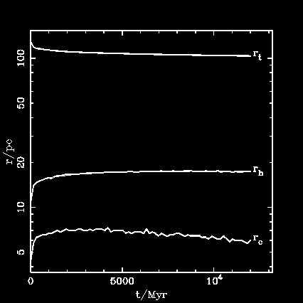
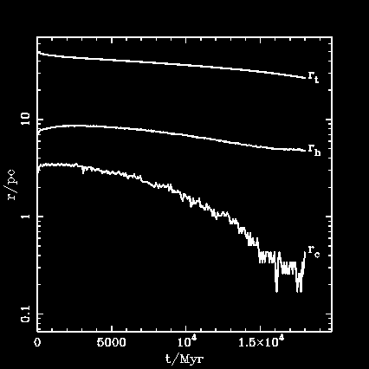
Models of Extended Clusters?
N = 100,000, 5% binaries, Z = 0.001, KTG IMF, Plummer/King
e.g. NGC6822 e.g. M31
Models of Faint Galaxy Production through Star Cluster Evolution

Slide 11
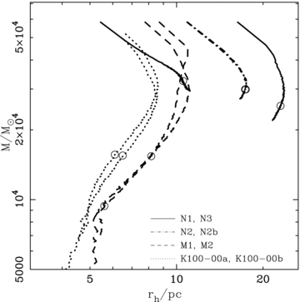
Models of Extended Clusters?
N = 100,000, 5% binaries, Z = 0.001, KTG IMF, Plummer/King
Hurley+Mackey10
Models of Faint Galaxy Production through Star Cluster Evolution

Slide 12
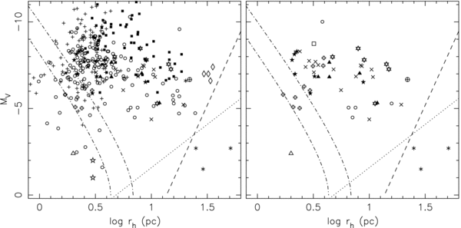
Models of Extended Clusters?
Da Costa+09
Models of Faint Galaxy Production through Star Cluster Evolution

Slide 13
Models of Extended Clusters?
Da Costa+09
Models of Faint Galaxy Production through Star Cluster Evolution

Slide 14
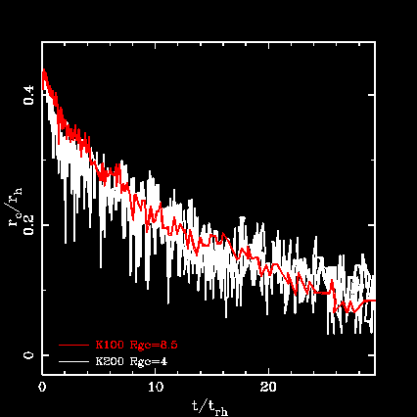
The N = 200,000 model
200k
2% binaries
R_{gc} = 4 kpc
100k
5% binaries
R_{gc} = 8.5 kpc
Models of Faint Galaxy Production through Star Cluster Evolution

Slide 15
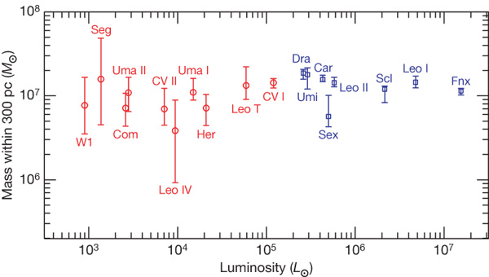
Models of Ultra-Faint Dwarfs?
31 127 132 308 170
size/pc
25 64 152 321 554
Strigari+08
sigma ~ 3-10 km/s
Models of Faint Galaxy Production through Star Cluster Evolution

Slide 16
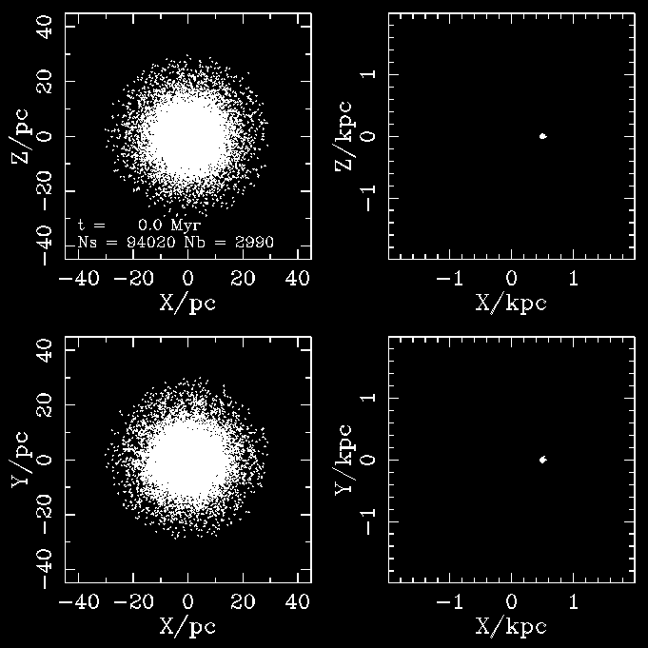
Models of Ultra-Faint Dwarfs?
M_{NFW} = 10⁹
c = 16
R_{gc} = 0.5 kpc
Models of Faint Galaxy Production through Star Cluster Evolution

Slide 17
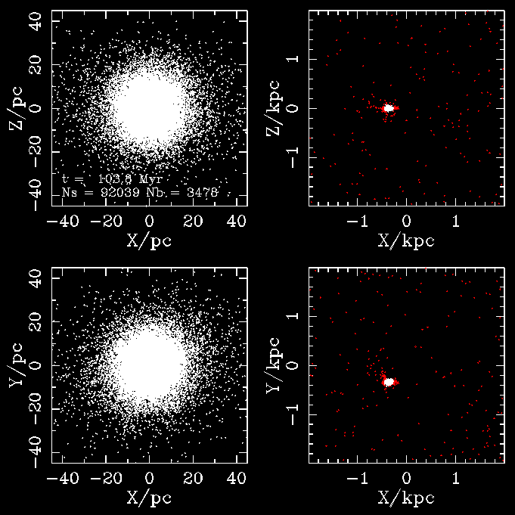
Models of Ultra-Faint Dwarfs?
M_{NFW} = 10⁹
c = 16
R_{gc} = 0.5 kpc
Models of Faint Galaxy Production through Star Cluster Evolution

Slide 18
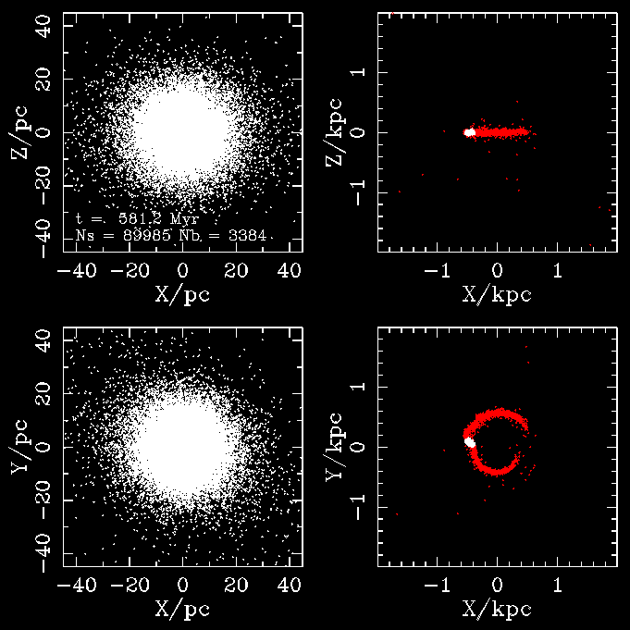
Models of Ultra-Faint Dwarfs?
M_{NFW} = 10⁹
c = 16
R_{gc} = 0.5 kpc
Models of Faint Galaxy Production through Star Cluster Evolution

Slide 19
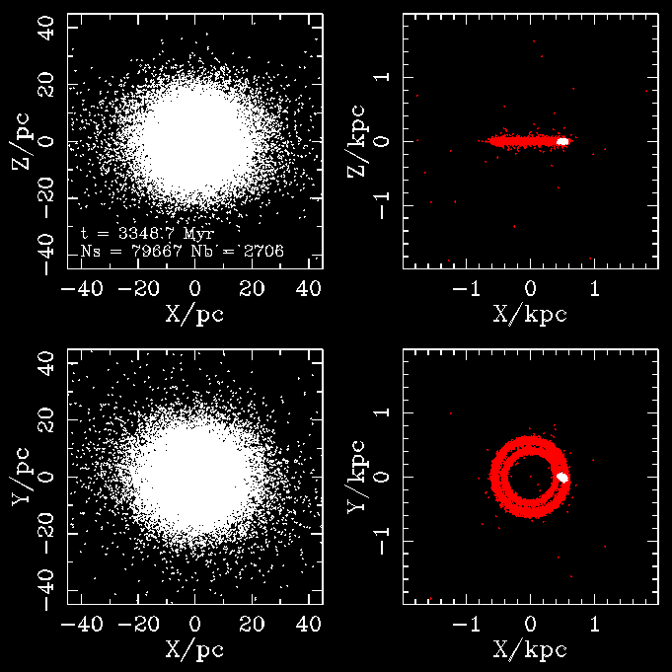
Models of Ultra-Faint Dwarfs?
M_{NFW} = 10⁹
c = 16
R_{gc} = 0.5 kpc
Models of Faint Galaxy Production through Star Cluster Evolution

Slide 20
Models of Ultra-Faint Dwarfs?
Star cluster near centre (R_{gc}=20pc), M_{NFW} = 10⁸, c=20
N = 100,000, 5% binaries N = 28,000, 40% binaries
Models of Faint Galaxy Production through Star Cluster Evolution

Slide 21
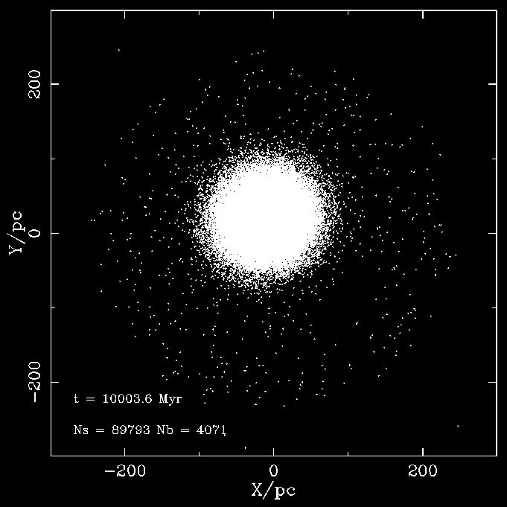
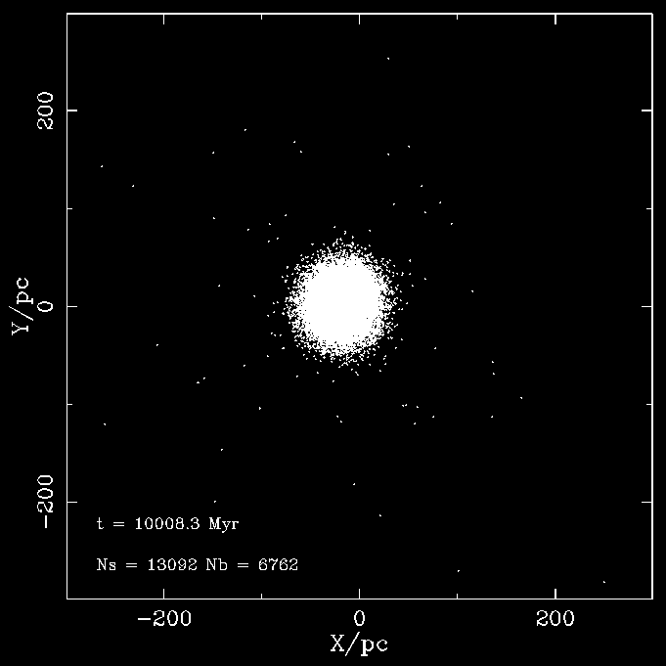
Models of Ultra-Faint Dwarfs?
Star cluster near centre (R_{gc}=20pc), M_{NFW} = 10⁸, c=20
N = 100,000, 5% binaries N = 28,000, 40% binaries
Models of Faint Galaxy Production through Star Cluster Evolution

Slide 22
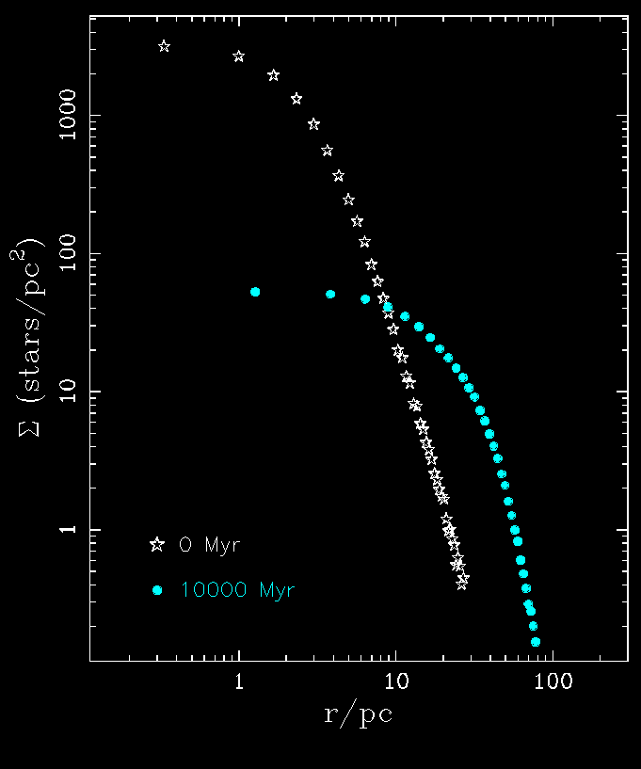
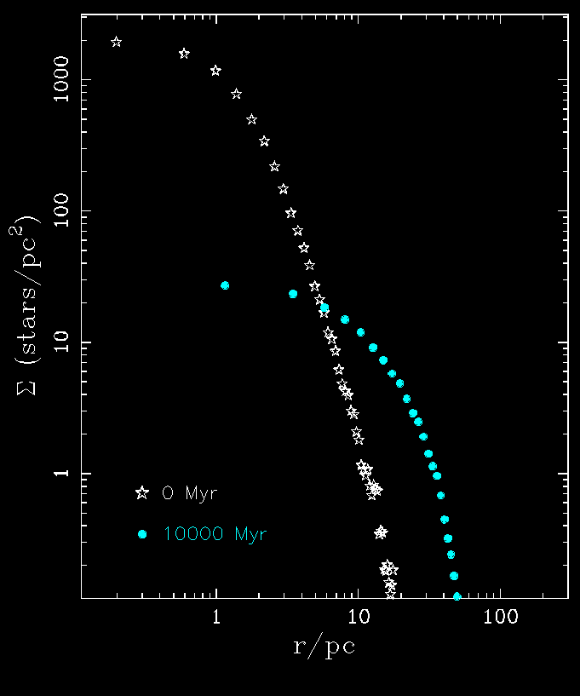
Models of Ultra-Faint Dwarfs?
Star cluster near centre (R_{gc}=20pc), M_{NFW} = 10⁸, c=20
N = 100,000, 5% binaries N = 28,000, 40% binaries
Models of Faint Galaxy Production through Star Cluster Evolution

Slide 23
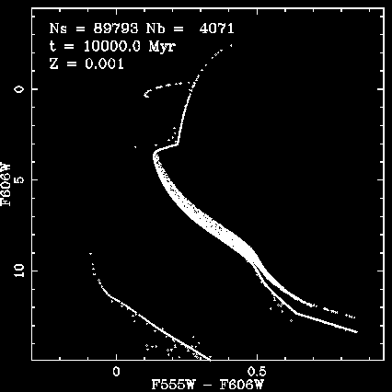
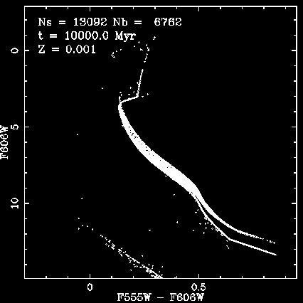
Models of Ultra-Faint Dwarfs?
Star cluster near centre (R_{gc}=20pc), M_{NFW} = 10⁸, c=20
N = 100,000, 5% binaries N = 28,000, 40% binaries
Models of Faint Galaxy Production through Star Cluster Evolution

Slide 24
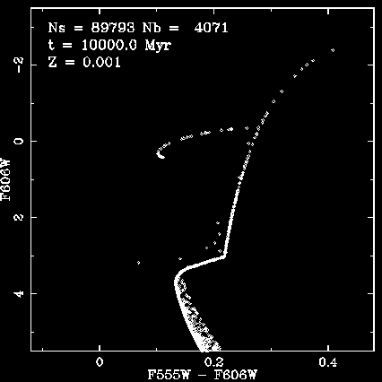
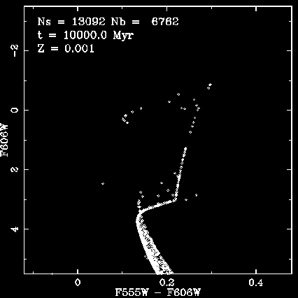
Models of Ultra-Faint Dwarfs?
Star cluster near centre (R_{gc}=20pc), M_{NFW} = 10⁸, c=20
N = 100,000, 5% binaries N = 28,000, 40% binaries
Models of Faint Galaxy Production through Star Cluster Evolution

Slide 25
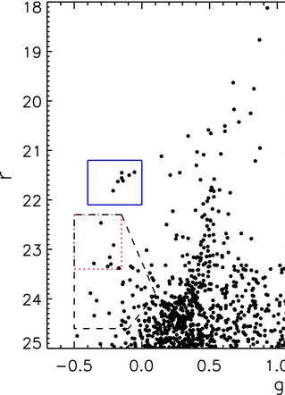
Models of Ultra-Faint Dwarfs?
Star cluster near centre (R_{gc}=20pc), M_{NFW} = 10⁸, c=20
N = 100,000, 5% binaries N = 28,000, 40% binaries
Sand+10
Leo IV
Models of Faint Galaxy Production through Star Cluster Evolution

Slide 26
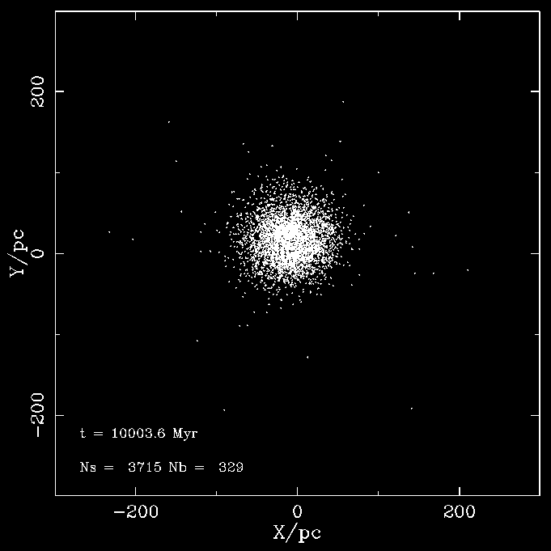
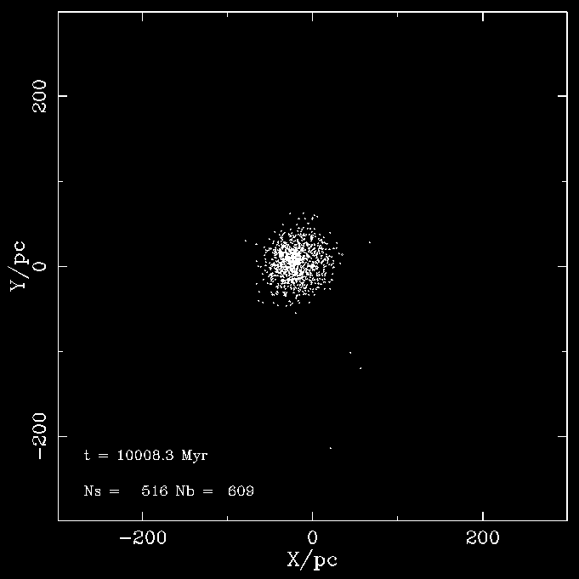
Models of Ultra-Faint Dwarfs?
Star cluster near centre (R_{gc}=20pc), M_{NFW} = 10⁸, c=20
N = 100,000, 5% binaries N = 28,000, 40% binaries
Models of Faint Galaxy Production through Star Cluster Evolution

Slide 27
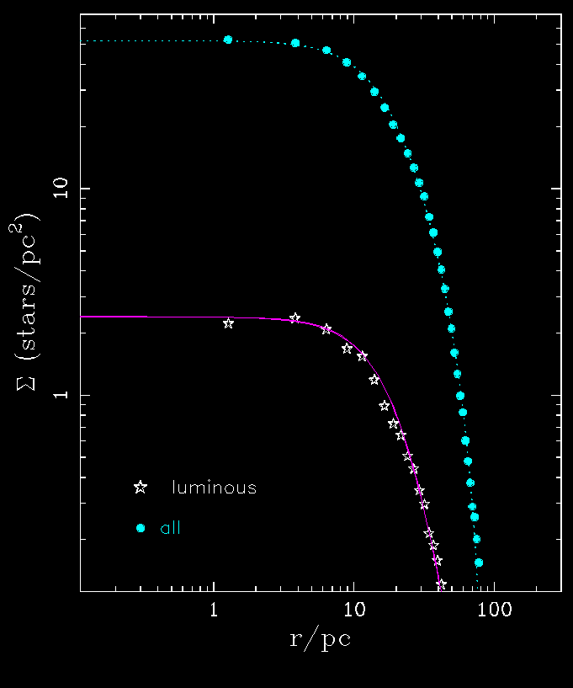
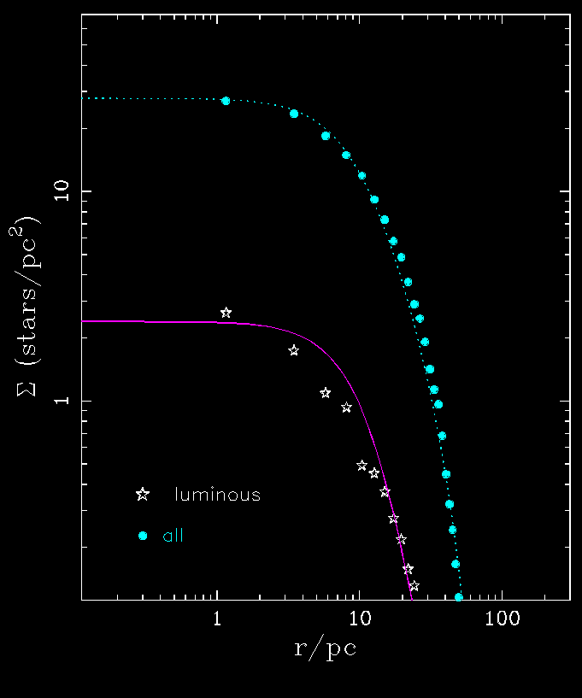
Models of Ultra-Faint Dwarfs?
Star cluster near centre (R_{gc}=20pc), M_{NFW} = 10⁸, c=20
N = 100,000, 5% binaries N = 28,000, 40% binaries
r_{pl} = 27 pc r_{pl} = 15 pc
Models of Faint Galaxy Production through Star Cluster Evolution

Slide 28
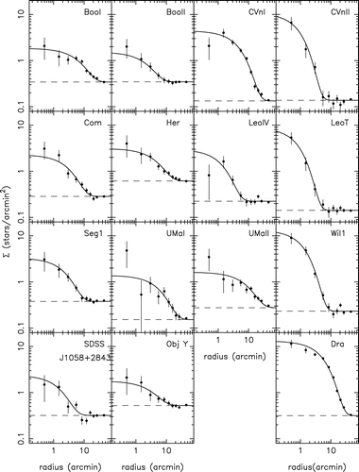
Models of Ultra-Faint Dwarfs?
Star cluster near centre (R_{gc}=20pc), M_{NFW} = 10⁸, c=20
N = 100,000, 5% binaries N = 28,000, 40% binaries
Martin+08
Models of Faint Galaxy Production through Star Cluster Evolution

Slide 29
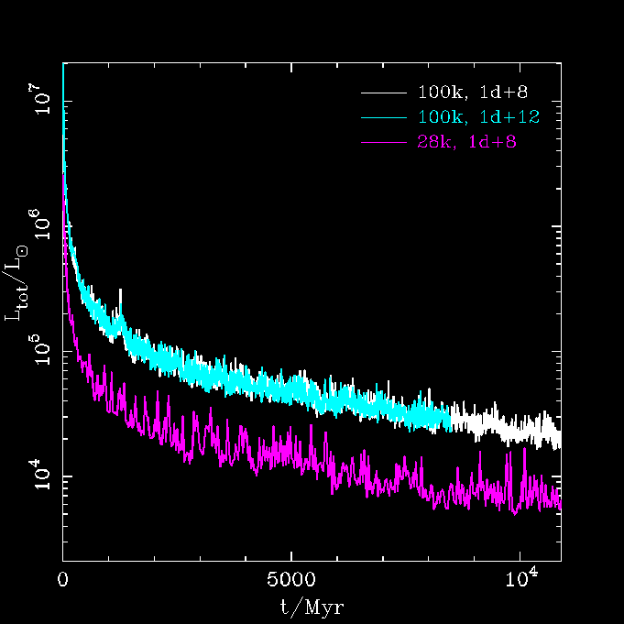
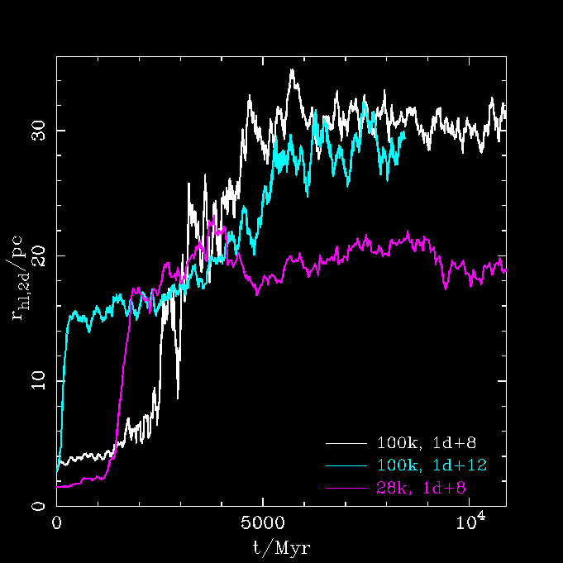
Models of Ultra-Faint Dwarfs?
M₃₀₀ ~ 0.7x10⁷ M_{sun} sigma ~ 5 km/s
Models of Faint Galaxy Production through Star Cluster Evolution

Slide 30
Future …
complex tidal fields
definition of tidal radius?
explore initial N, f_{b}, density, sigma …
non-virial protoclusters, e.g. Hurley+Bekki08
include gas?
…
Models of Faint Galaxy Production through Star Cluster Evolution

Slide 31
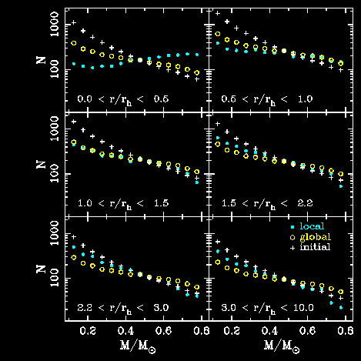
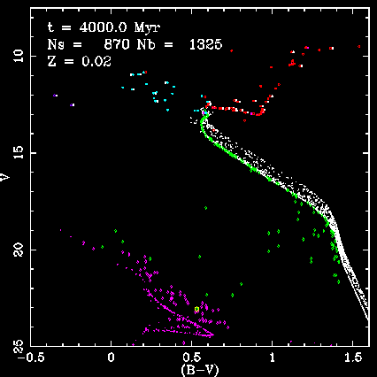
N-body simulation background

